Slide 1
Landsat Collection 2 MODIS-VIIRS Transition Update Landsat Science Team February 2023
Saeed Arab^{1*}, Christopher Crawford²
¹ KBR, contractor to the U.S. Geological Survey (USGS) Earth Resources Observation and Science (EROS) Center
² U.S. Geological Survey (USGS) EROS Center
*Work performed under USGS contract 140G0121D0001.
Notes:
Briefly touch on atmos aux vars used in Landsat 8-9 Level-2 SR processing
- Extensively covered at the summer LST, and laid out a transition timeline
Unfortunately, as part of that timeline we had a big dependency on the external data which impacts the transition timeline
So we decided to revisit the topic here one more time, and provide an update on the timeline

Slide 2
Outline
Recap of Summer 2022 LST meeting presentation
Requested Recommendation in Summer LST
Availability of VIIRS CMG dataset
Updated Transition Plans
Notes:
Do a recap of summer LST and recommendation we made for the transition
Then we can talk about the updated timeline

Slide 3
Current Sources of L8-9 SR Atmospheric Auxiliary
Atmospheric Data (In the order of impact) | Land Surface Reflectance Code (LaSRC) Internal radiative transfer model
Aerosol Optical Depth | First the NDVI_{SWIR} (referred to as NDWI) is computed internally $${NDVI}_{SWIR}=\frac{NIR −{SWIR}/2}{NIR+{SWIR}/2}$$ This is based on assumption that the SWIR and red ratio is around 0.5 over most surfaces (Similar to DDV method) Second, the MODIS CMG-derived ratio maps are used to capture the potential seasonal/annual variability of the ratio (between the red and blue band). Using the values in AOT LUT, the Surface Reflectance for two blue bands and SWIR2 are calculated. A measure of the goodness of inversion is computed using two blue bands to find the optimum AOT. $$residual=\sqrt{\frac{{(ρ_{s}^{1}− {r_{1,4}ρ}_{s}^{4})}^{2}+{(ρ_{s}^{2}− {r_{2,4}ρ}_{s}^{4})}^{2}}{2}}$$ This is essentially the same as LEDAPS condition.
Ozone | MODIS surface reflectance Climate Modeling Grid (M[O/Y]D09CMG)
Water Vapor | MODIS surface reflectance Climate Modeling Grid (M[O/Y]D09CMA)
Atmospheric Pressure | Derived from a combination of coarse-resolution weather-prediction model, available from NCEP GDAS, sea level pressure (P_{sl}), and altitude (z) derived from DEM $$P=P_{sl}e^{−z/8}$$
Notes:
As a refresher, the column water vapor and total ozone information required for successful processing of Land Surface reflectance code
We rely on MODIS CMG for that information, primarily morning information from Terra, with aqua being the fallback.

Slide 4
End of Terra/Aqua Missions
End of Terra/Aqua science observations anticipated in summer FY2023
Current thinking from NASA HQ leadership: End of missions will likely be in FY2023
These missions are invited to senior review but science products availability beyond FY2023 is TBD(?).
Terra Constellation Exit Maneuvers completed (October 2022).
MODIS science observations continue in concert with the changing MLT at lower orbit (694 km).
NASA’s Terra, Aqua, and Aura Drifting Orbits Workshop (November 2022)
Terra:
Last maneuver
10:30 AM
Began drifting
Constellation exit
10:15 AM
Data collection stops
9:00 AM MLT crossing
Feb 2020
Mar 2021
Apr 2021
Jul 2021
Jan 2022
Oct 2022
FY 2023
Dec 2025
Aug 2026
Aqua:
Last maneuver
1:30 PM
Began drifting
3:50 PM MLT
Constellation exit
Notes:
As you all know, Terra/Aqua and Aura for that matter are nearing the end of mission
Last we heard from our nasa colleagues, the end of these missions is likely in current fiscal year.
Apparently, the missions are invited to science review but science product generation and distribution beyond Sep 2023 is TBD
Anyhow, since we met in Summer, the Terra team had two constelleation exit manuevers in October.
They had a drifting orbits workshop, we attended the land breakout session. Looked like there is a big diurnal sampling opportunity
But from we heard and have seen, we have not seen a systematic impact on Landsat SR as a result of changing MLT crossing time, yet

Slide 5
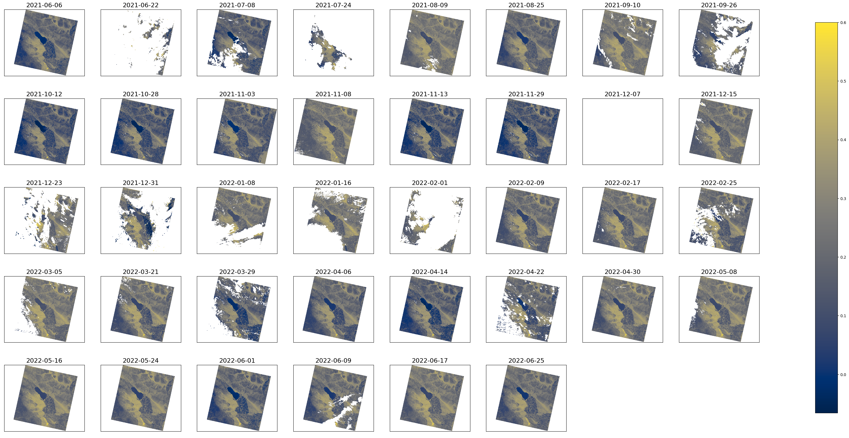
Time Series Analysis
1 year of Landsat 8 and 9 acquisitions over WRS-2 P39/R37 (total of 38)
Cloud and Shadow contaminated pixels are masked
Surface Reflectance is processed using both MODIS and VIIRS O3 and WV
Notes:
Here is the a short version of the analysis we showed at the summer LST.
Picked a scene in southwestern U.S over the salton sea and grabbed all the L8-9 acquisitions over one full year from summer of 2021 to summer of 2022
And processed the scenes using both MODIS and VIIRS

Slide 6
MODIS vs VIIRS Atmospheric Measurements
Notes:
Here is the profile of ozone and water vapor at the scene center over that period.
Top panel: Ozone data are nearly identical.
bottom panel: differences between the morning and afternoon water vapor measured by modis/viirs respectively. Some differences visible during the monsoon season
Water Vapor: g/cm² → 1 g/cm² = 10 kg/m²
Ozone: 1 atm-cm = 1000 DU

Slide 7
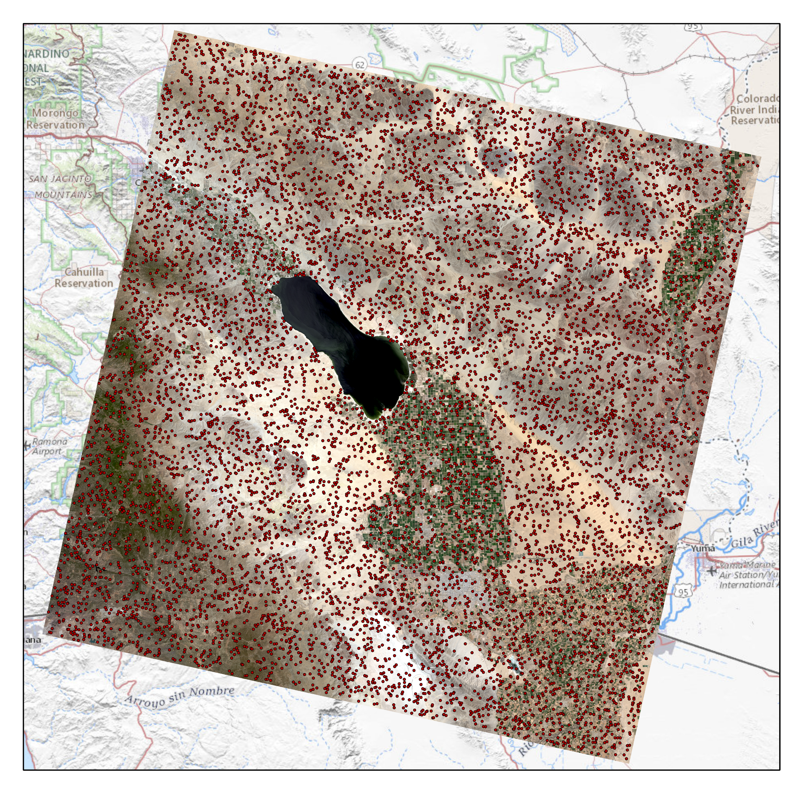
Surface Reflectance at Random Pixels
N = 10,000 points randomly selected across the scene
Time series of average SR summarized (regardless of land cover type)
Notes:
We grabbed the average reflectance over a number of random pixels.

Slide 8
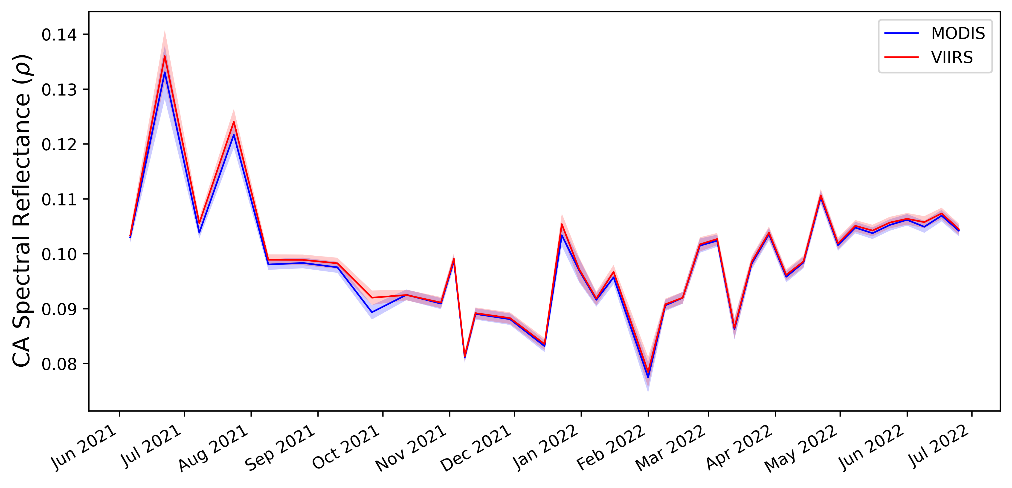
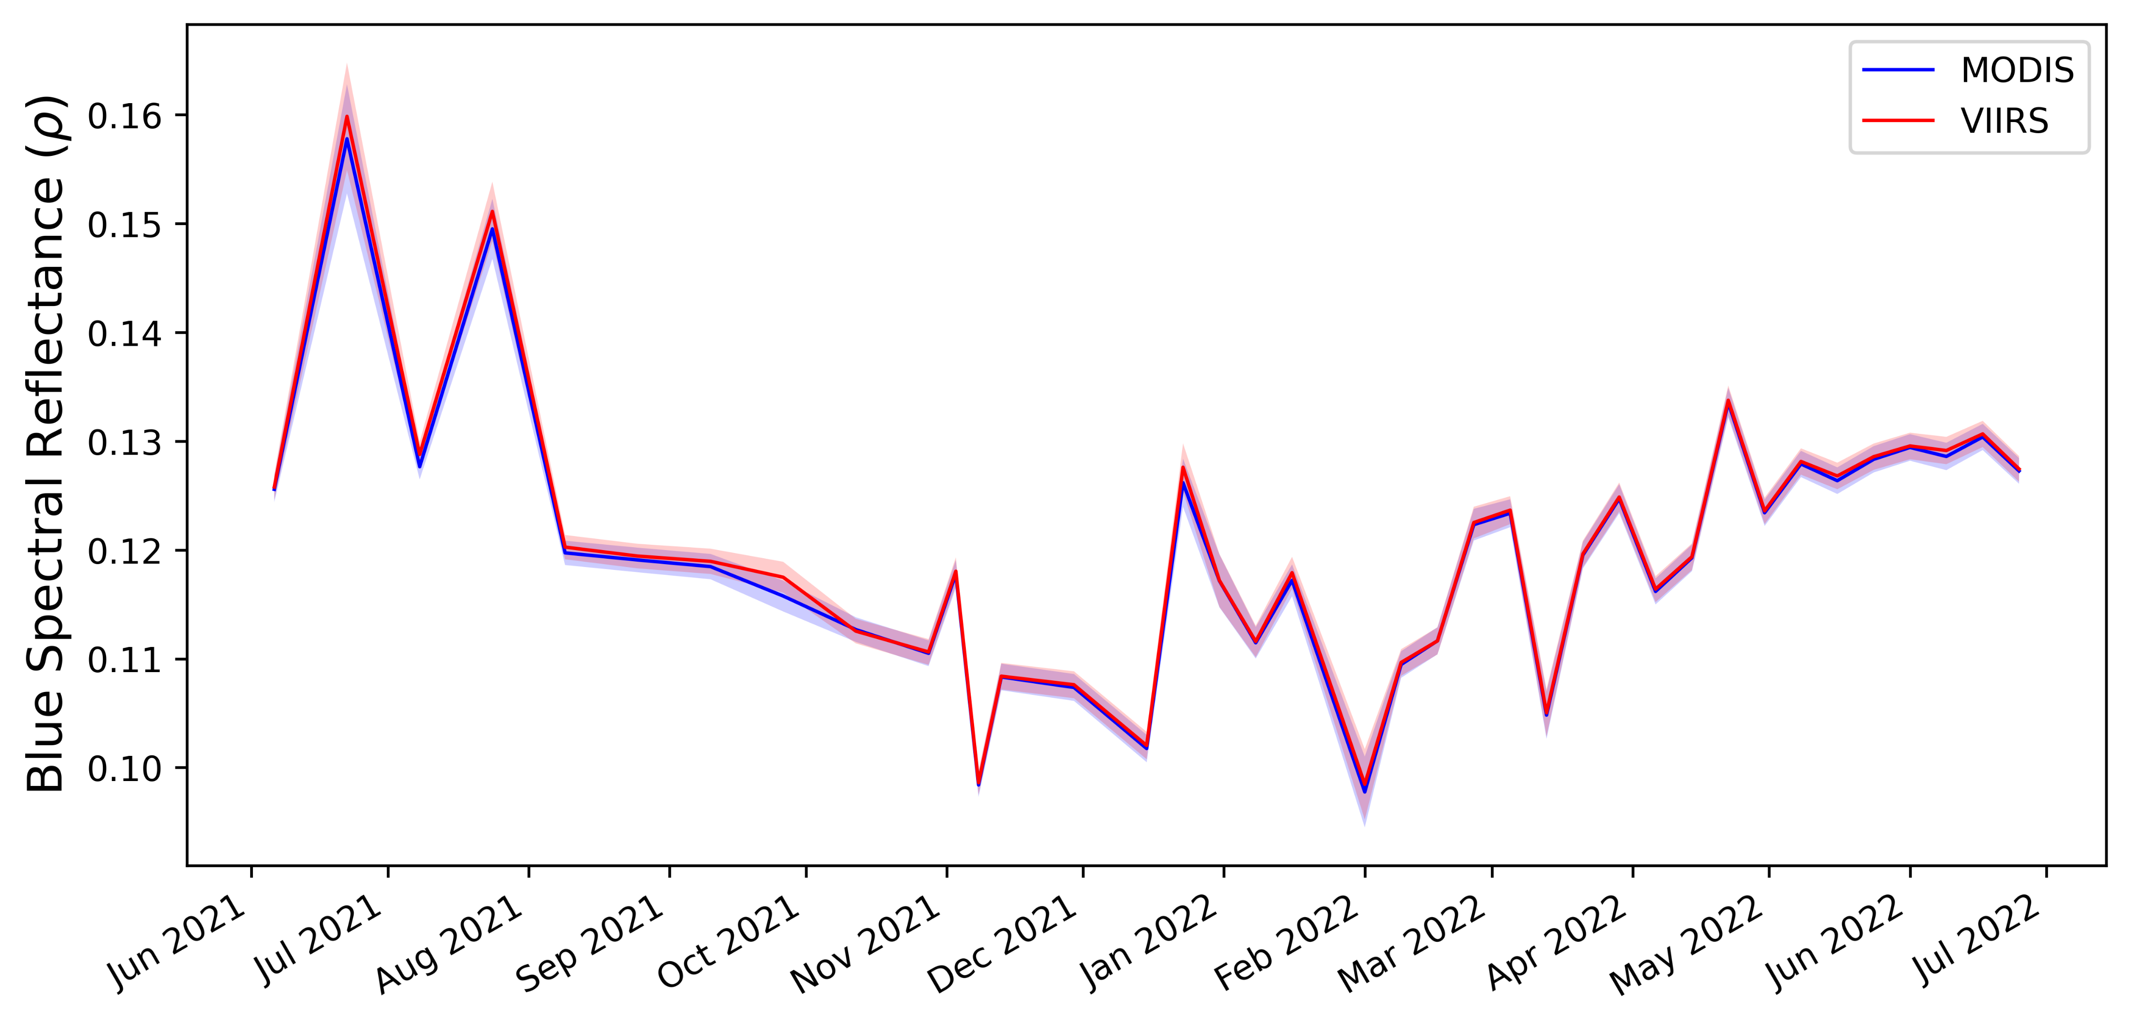
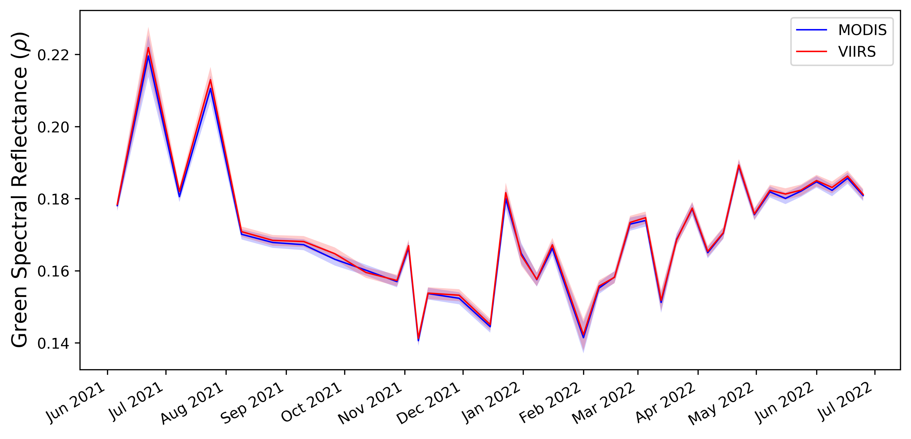
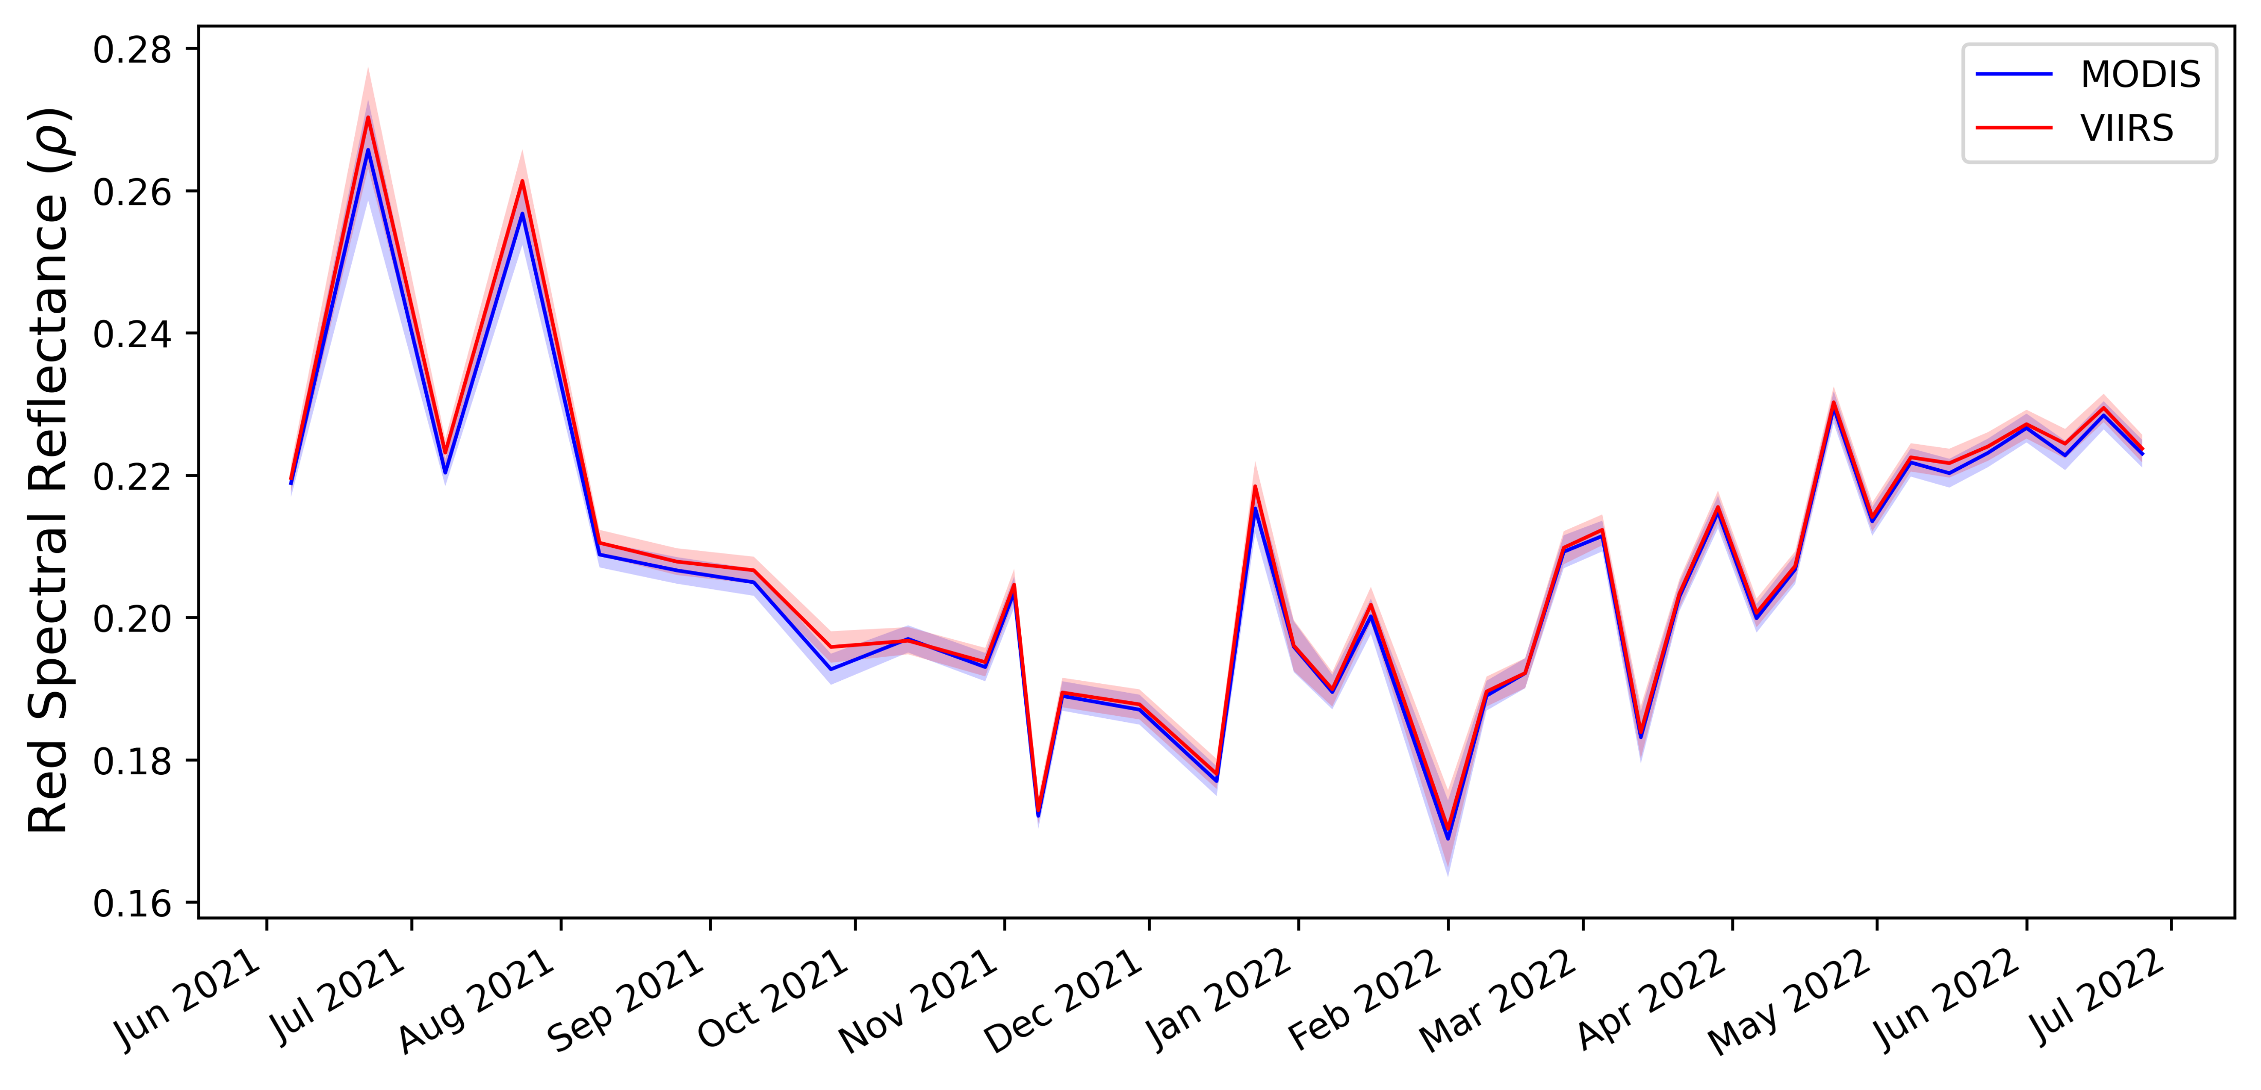
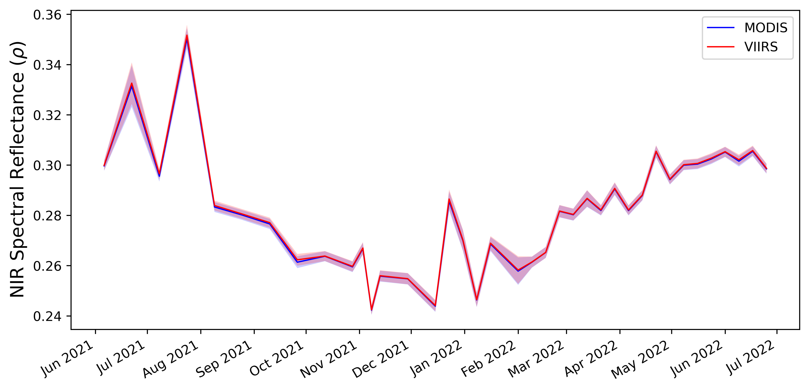
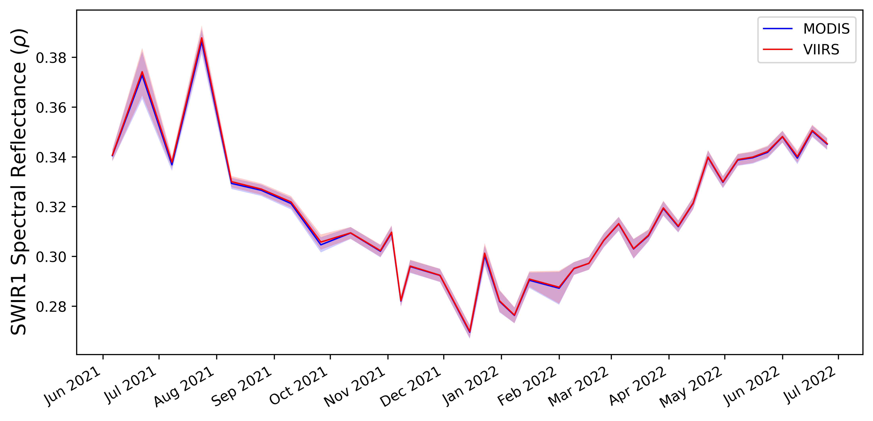
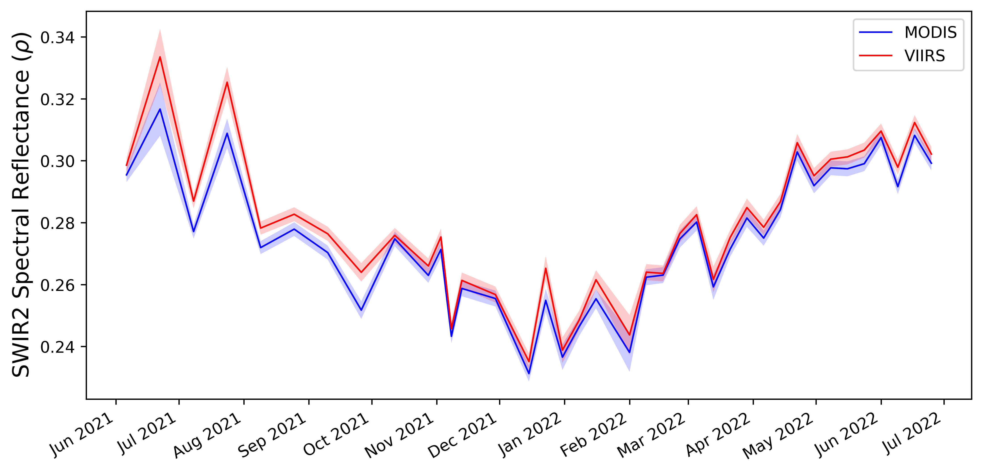
Time Series of SR Bands
Good agreement across all SR Bands
Very small VIIRS overestimation visible for SR B4 (Red) during monsoon season
Visible separation for SWIR2 band (ρ_{VIIRS} ≥ ρ_{MODIS}).
Monsoon
Dry
Notes:
And here is the time series of surface reflectance for all VSWIR bands during that period + 95% CI
Some overestimation especially during monsoon season due to larger WV variations
Interesting differences in SWIR2 channel. Red and SWIR2 stood out as most sensitive.
By large, the differences were small and within LaSRC uncertainty.
Dec-Feb (winter), May-June (dry season), and July-September (monsoon season

Slide 9
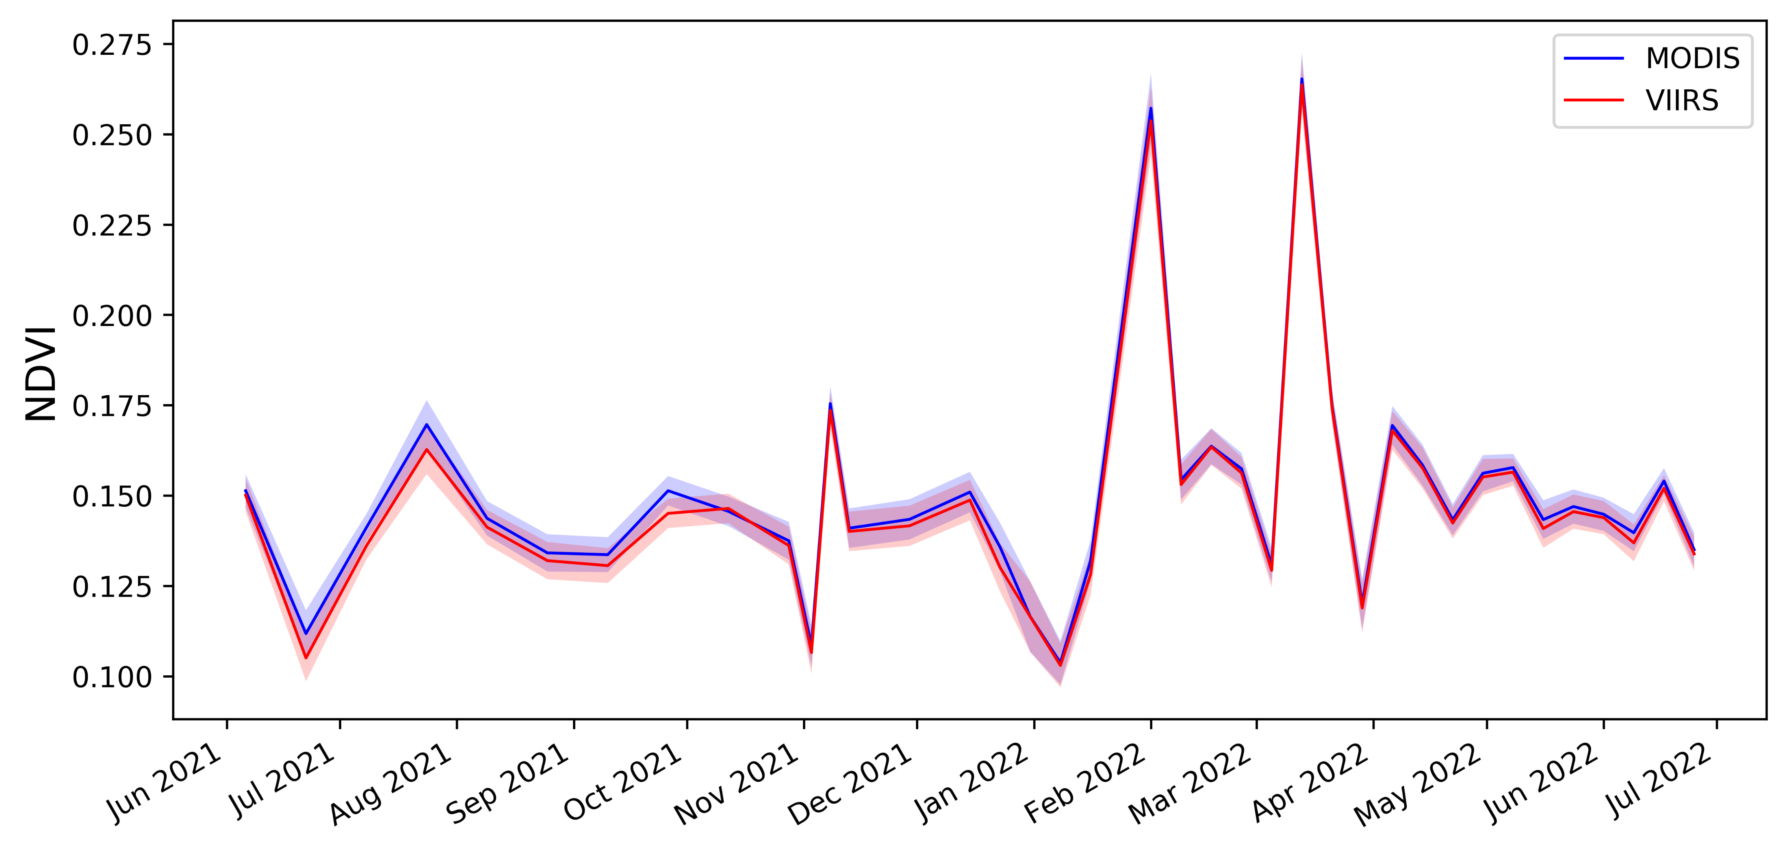
Average NDVI
The VIIRS-derived NDVI is slightly smaller than MODIS during monsoon season (caused by SR B4 overestimation).
Notes:
We also looked at some spectral indices, NDVI as an example. Very well correlated
Some over estimation visible, again during the monsoon season.

Slide 10
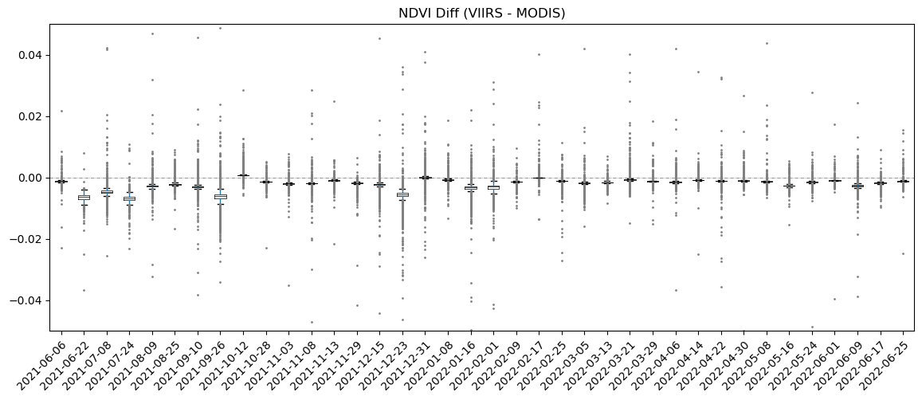
Boxplots of NDVI Difference
VIIRS derived NDVI is generally smaller, with absolute difference smaller than 0.02.
Notes:
The average and CI does not do the justice. Differences are more visible in boxplot.

Slide 11
Recommendation Requested in August 2022 LST
The SR differences are dependent on atmospheric condition and wavelength driven. In all cases the magnitude of change is small and within uncertainty of Landsat LaSRC algorithm.
Proceed with the transition of both L8 and L9 to the VIIRS CMG in Winter 2023
Timeline of transition
Official release of VIIRS CMG products including documentation expected in October 2022
Recommended date: 1/1/2023
Notes:
With that analysis, here is the recommendation that we put in front of LST and asked for approval. We were targeting winter 2023 (Jan 1st) as a clean transition date.
But that was based on the assumption of external data availability. Our expectation was for VIIRS CMG to become available by October. That didn’t happen.
Terra’s 10:15am MLT crossing time will reach 9:00 AM (75 min) over the course of 3 years (October 2022 to December 2025).

Slide 12
External Data Dependency
Processing and distribution of the VIIRS CMG data by LAADS DAAC went slower than anticipated.
LAADS Stream 2 (2021 – Present) processing Status (as of 2/6/2023)
VNP04ANC: currently processing Day 139 of 2022
VJ104ANC: currently processing Day 174 of 2022
The most recent update (as of mid-January):
Processing of 2022 data should be completed by the first week of March.
It’ll take about 10 more days to catch up to the leading edge.
The Landsat Product Generation System (LPGS) software updates will be ready about 1 month after availability of forward-processing stream data (mid-late April)
Notes:
VIIRS CMG processing was slower than predicted.
LAADS team has set up two processing streams for VIIRS processing. The forward stream is what we are interested in. They are currently processing middle of 2022 data. And are expecting to finish in middle of march.

Slide 13
Where and when Terra is now?
No significant difference expected in quality of MODIS Terra between April and September 2023 (Landsat MLT equatorial crossing of 10:00 AM ± 15 min)
April 2023
September 2023
Notes:
Looking at where Terra is between now and end of the FY, we do not anticipate significant differences in Level-2 sr processing.

Slide 14
Updated Transition Plans
USGS is currently planning to wait until the end of FY23 (9/30/2023)
USGS will be ready around mid-April (assuming no further delays in availability of the VIIRS CMG).
This will be right after the Autumn Equinox (Sep 23) which is towards the end of growing season for majority of the Continental U.S.
In the event of Terra mission extension beyond FY23 (slim chance?), Winter 2024 (01/01/2024) is a preferred transition date.
USGS will proceed with this plan and communicate with users, if there is no objection from the Landsat Science Team.
Notes:
And here is my last slide, with all of that we are currently targeting an end of FY for transition.
All pieces should be ready for transition in mid-march (assuming no further delays in VIIRS availability).
We will be ready to go as soon as mid-April, if we need to make transition. But we will wait until the end of FY. That will be towards the end of growing season for majority of the US. Having that growing season in mind, and trying to minimize the impacts on the users.

Slide 15
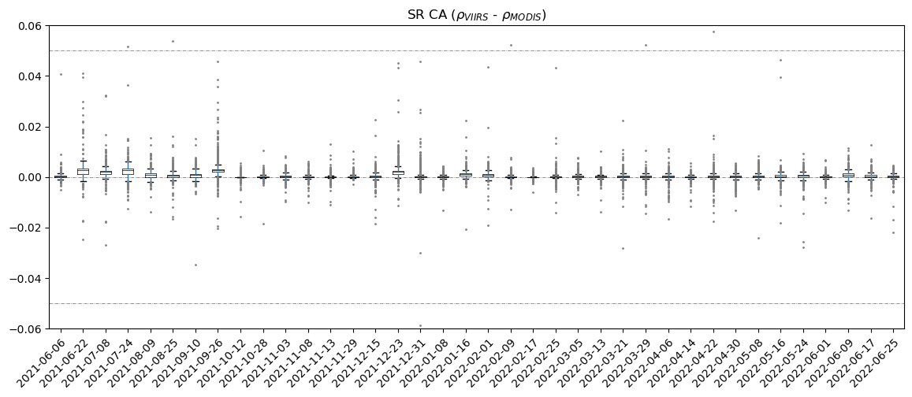
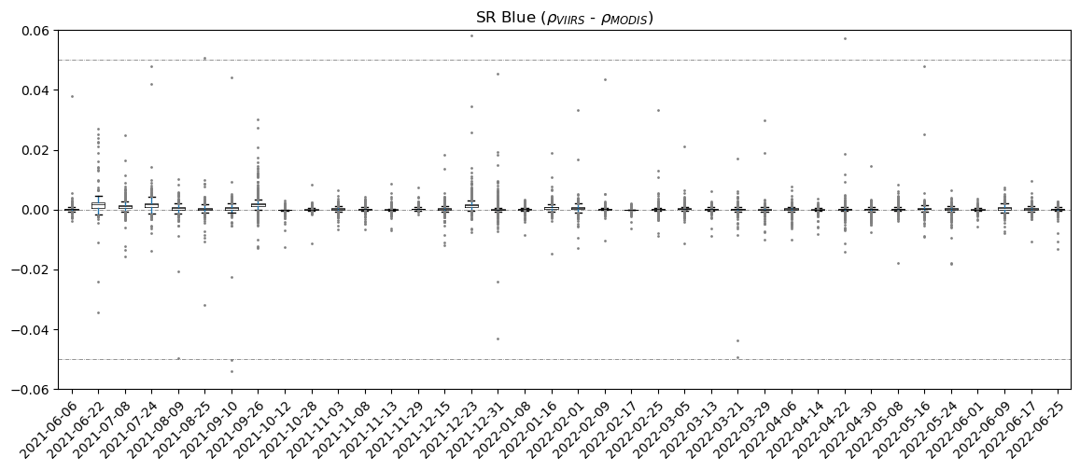
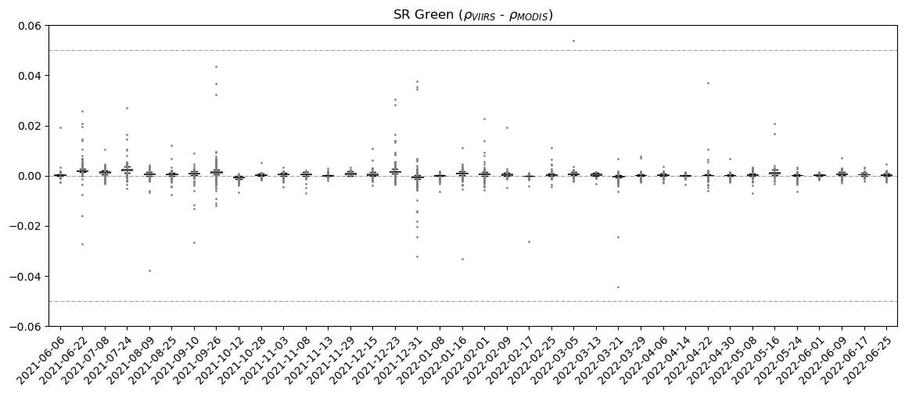
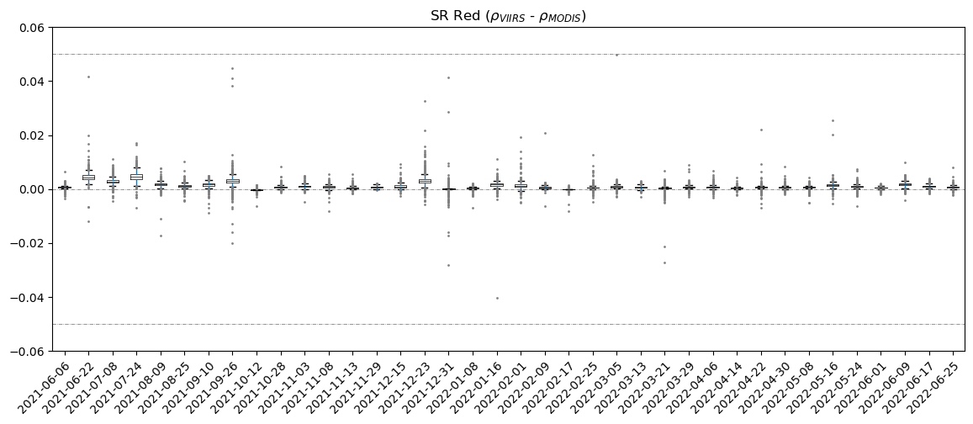
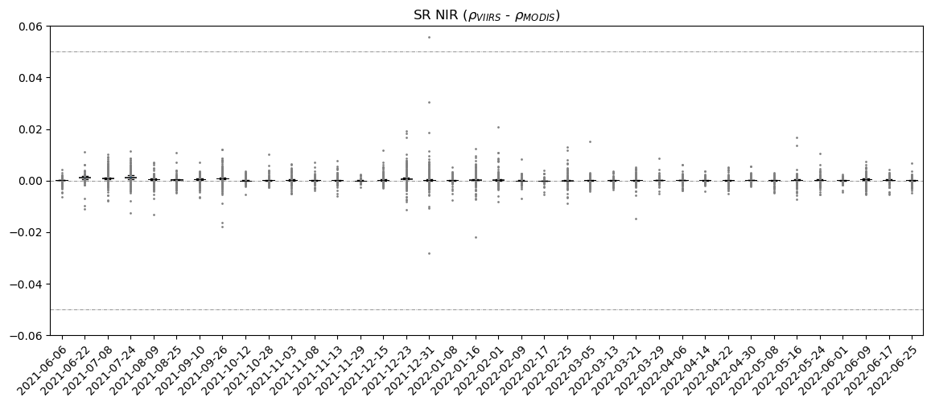
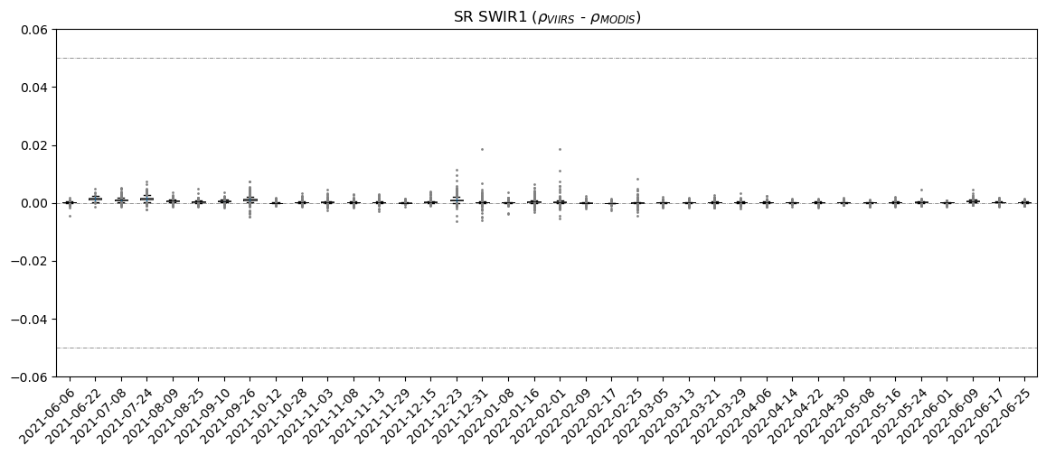
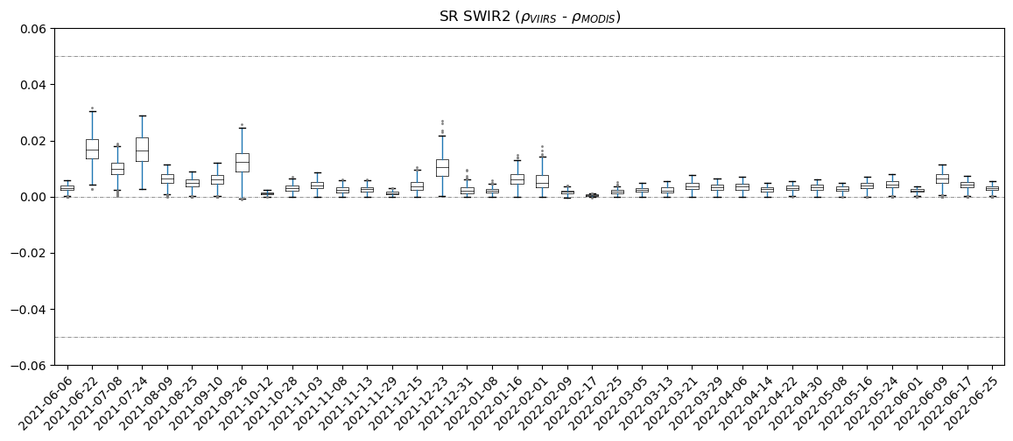
Surface Reflectance Difference
Slight overestimation for CA, Red, and SWIR2 channels

Slide 16
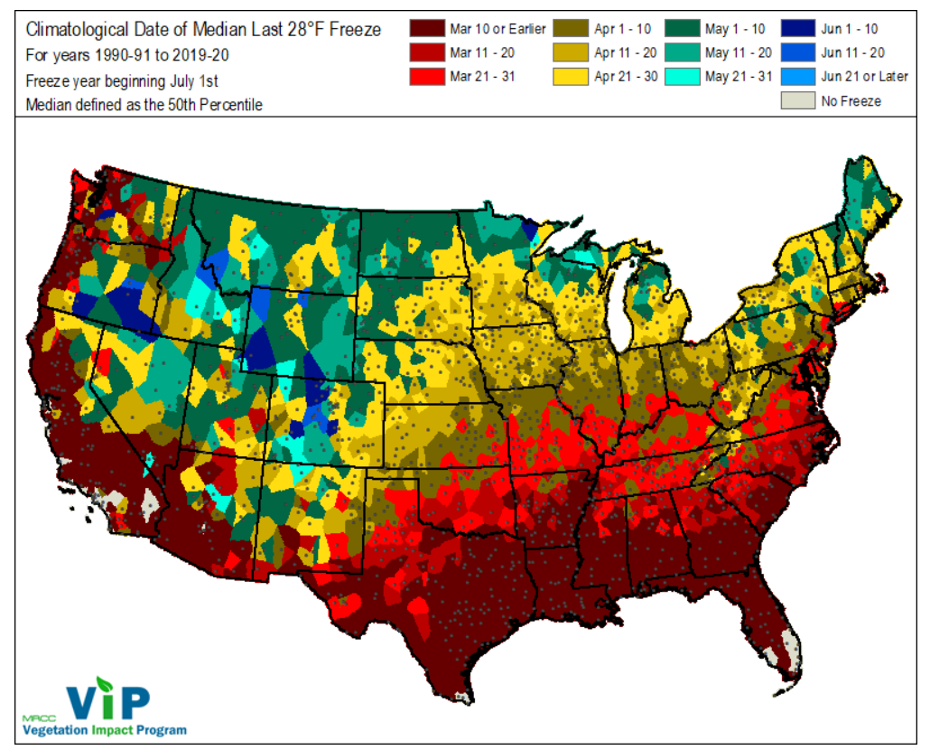
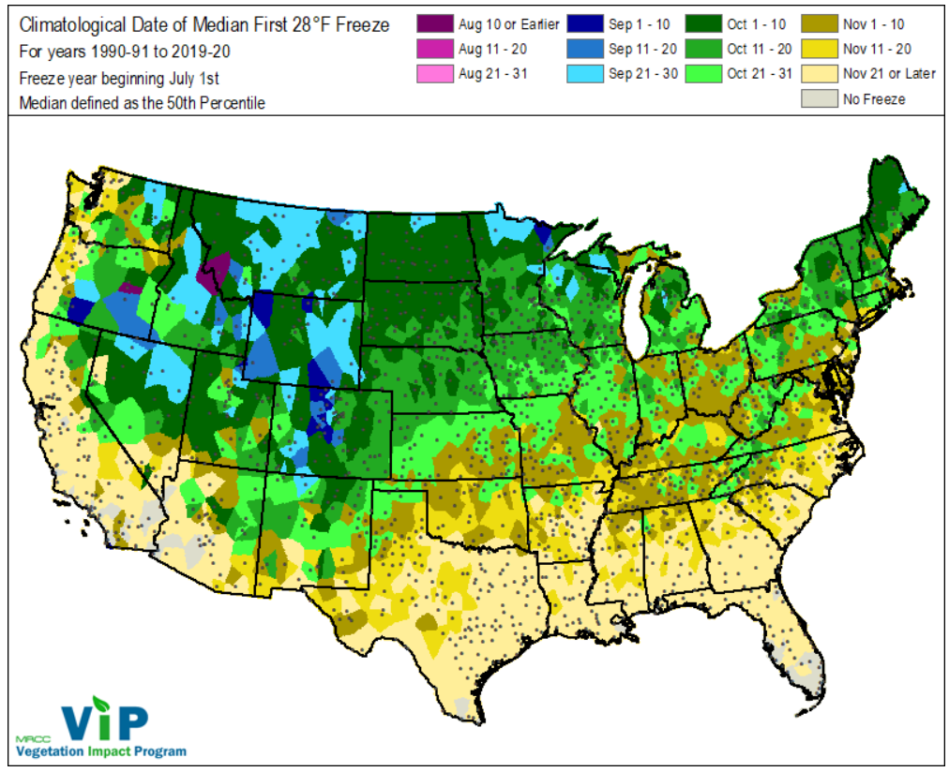
Growing Season in Continental U.S.
For majority of the U.S., the median growing season has been between late April to early October over the past 3 decades.
Source: Purdue's climatological median last and first freeze https://mrcc.purdue.edu/VIP/frz_maps/freeze_maps.html#frzMaps
Notes:
USDA's plant hardiness zone maps: https://planthardiness.ars.usda.gov/, or
Purdue's climatological median last and first freeze https://mrcc.purdue.edu/VIP/frz_maps/freeze_maps.html#frzMaps

Slide 17
Backup
Backup

Slide 18
Boxplots of SR Band 4 Difference
The IQR in most scenes is above Diff=0 line (75% of pixels have greater SR B4 when using VIIRS input)
For most scenes the differences are within ±0.05 threshold.

Slide 19
Boxplots of SR Band 7 Difference
The SR B7 differences are always positive
The magnitude of difference is < 0.03.

Slide 20
Boxplots of SR Band 5 Difference
Better agreement for SR B5
The differences are small and near zero for most scenes.

Slide 21
Alternative Sources of Ozone and Water Vapor
Criteria
Continuity/consistency of Landsat SR product
Providing global coverage
Minimal latency for forward processing of Landsat SR
Spatial and temporal resolutions
Data access, file format, measurement units, etc.
Types of alternative sources
Direct measurements/products from the EO missions
Near-polar sun-synchronous orbits (global coverage)
Equator-crossing time
Atmospheric reanalysis products

Slide 22
Mission Data - Total Ozone (TOZ)
List of current, approved, and planned missions
http://database.eohandbook.com/timeline/timeline.aspx?measurementParameterID=33
Product | Sensor | Temporal resolution | Horizontal resolution | Coverage/Position | Agency | Mission | Operational since | Local equator crossing time | Approximate Latency | Note
Ozone | MODIS | Daily | 1 Km | Global | NASA/GSFC | Terra | 1999 – Present | 10:30 am | 2 days
 |  |  |  |  |  | Aqua | 2002 – Present | 1:30 pm | 2 days
Total column and vertical profile ozone | OMPS | Daily | 50 Km | Global | NOAA/GSFC | Suomi NPP | 2011 – Present | 1:30 pm | 6 days | https://www.avl.class.noaa.gov/
 |  |  |  |  |  | JPSS-1 (NOAA-20) | 2017 – Present | 1:30 pm | 1 day
Vertical ozone profile | GOME-2, IASI | Daily | GOME-2: 40 Km IASI: 12 Km IASI | Near-Global | EUMETSAT | Metop-A, B, and C | 2006 – Present | 9:30 am | 1 day | https://www.eumetsat.int/website/home/Data/Products/Atmosphere/
Total Ozone product | HIRS/4, SBUV/2 | Daily | 1 degree | Global | EUMETSAT | Metop-A, B, and C | 2006 – Present | 9:30 am | 2 days
Total Ozone | OMI, HiRDLS, MLS, TES | Daily | 13 km x 25 km | Global | NASA/GSFC | Aura | 2004 – Present | 1:45 pm | 3 days
Total Ozone Column | Tropomi | Daily | 28 x 21 Km | Global | ESA/ EUMETSAT | Sentinel-5 Precursor | 2017 - Present | 1:30 pm | 5 days | https://scihub.copernicus.eu/dhus/
Total Ozone | HIRS/4, SBUV/2 | Daily | 1 degree | Global | NOAA | NOAA-18 | 2005 – Present | 2:58 pm | Up to 60 days | https://www.avl.class.noaa.gov/
 |  |  |  |  |  | NOAA-19 | 2009 - Present | 1:34 pm
TOZ | SEVIRI | 5-15 min | 1 – 3 Km | 0, 3.5, 9,5, 41.5 E | EUMETSAT | Meteosat-8, 9, 10, 11 | 2002 – Present | - | 3 hours | Geostationary
Total Column Ozone | Sounder | 30 min | 10 Km | 60, 105, and 128W | NOAA | GOES-13, 14, 15 | 2006 – Present | - |  | Geostationary
Ozone Profile | TANSO-FTS2 | 3 days | 1 Km | Global | JAXA | GOSAT-2 | 2018 – Present | 1:00 pm
Ozone vertical profile | SAGE-III | 1-5 days |  |  | NASA | ISS | 2017 – Present | Varies |  | Low Earth Orbit
Total column ozone | EPIC | Daily | 20 Km | Global | NOAA/NASA | DSCOVR | 2015 – Present | - | 1 day | Sun-Earth L1 Lagrange
Notes:
Columnar ozone = TOZ
SEVIRI (Meteosat Second Generation [MSG])
Solar Backscatter Ultraviolet Radiometer = SBUV/2
HIRS/4 (High Resolution Infrared Sounder)
Greenhouse Gases Observing Satellite-2 (GOSAT-2)
TANSO-FTS (Thermal And Near infrared Sensor for carbon Observation - Fourier Transform Spectrometer)
Deep Space Climate Observatory(DSCOVR) Earth Polychromatic Imaging Camera (EPIC)
Stratospheric Aerosol and Gas Experiment (SAGE III)
UVNS (Ultraviolet Visible Near-Infrared Shortwave (infrared))
Ozone Mapping and Profiler Suite (OMPS)

Slide 23
Mission Data - Water vapor
Product | Sensor | Temporal resolution | Horizontal resolution | Coverage/Position | Agency | Mission | Operational since | Local equator crossing time | Approximate Latency | Note
Precipitable water vapor | MODIS | Daily | 1 Km | Global | NASA/GSFC | Terra | 1999 – Present | 10:30 am | 2 days | NIR wavelength
 |  |  |  |  |  | Aqua | 2002 – Present | 1:30 pm | 2 days | NIR wavelength
Water vapor / Total precipitable water | CrIS / ATMS | Daily | Intermediate Product: 0.75 Km EDR: 6Km / 16 Km | Global | NOAA/NASA | Suomi NPP | 2011 – Present | 1:30 pm | 1-2 days | TIR wavelength
 |  |  |  |  |  | NOAA-20 (JPSS-1) | 2017 – Present | 1:30 pm | 1 day
Water vapor profile / Vertically integrated water vapor | IASI, HIRS/4 | Daily | 40 x 40 km2 associated to 960 km swath | Near-Global | EUMETSAT | Metop-A | 2006 – Present | 9:30 am | 1 day | https://www.eumetsat.int/website/home/Data/Products/Atmosphere/ Visible and TIR wavelength
 |  |  |  |  |  | Metop-B | 2012 – Present
 |  |  |  |  |  | Metop-C | 2018 – Present
Water vapor | AIRS | Daily | 90 Km | Global | NASA | Aqua | 2002 – Present | 1:30 pm | 2 days | TIR wavelength
Columnar atmospheric water vapor | AMSR2 | Daily | 10 Km | Ocean | JAXA/NASA | GCOM-W1 | 2012 – Present | 1:30 pm
TCWV | OCO | 16 days | 1.3×2.3 Km | Global | NASA’s Afternoon Constellation | OCO-2 | 2014 - Present | 1:30 pm
Notes:
Advanced Technology Microwave Sounder (ATMS)
MEdium Resolution Imaging Spectrometer MERIS
Atmospheric Infrared Sounder (AIRS)
Infrared Atmospheric Sounding Interferometer (IASI)
Cross-track Infrared Sounder CIS
High-resolution Infrared Radiation Sounder HIRS
Special SensorMicrowave Imager (SSMI) and Special Sensor Microwave Imager/Sounder (SSMIS) are both part of DoD DMSP program.
Orbiting Carbon Observatory-2 (OCO-2).
Tropical Rainfall Measuring Mission (TRMM) Microwave Imager launched in 1997 (of DMSP SSM/I heritage).
Global Precipitation Measurement (GPM) Microwave Imager (GMI).
Defense Meteorological Satellite Program (DMSP)
Over ocean, microwave and infrared sensors are typically used, as the surface temperature and emissivity are relatively well known. Over land, emissivity constraints result in a preference toward near-infrared sensors.

Slide 24
Atmospheric Reanalysis
Reanalysis grid | Horizontal Resolution | Temporal Coverage | Temporal resolution | Latency
ECMWF ERA5 (~25Km) Total Column Ozone tco3 [kg/m2]; Source: GOME, GOME-2, MIPAS, MLS, OMI, SBUV, SBUV/2, SCIAMACHY, TOMS Total Column Water vapor tcvw [kg/m2]; Source: AMSR-2, AMSRE, GMI, SSM/I, SSMIS, TMI, MVIRI, SEVIRI, GOES IMAGES, MTSAT IMAGER, AHI | 0.25 deg | 1979 - Present | Hourly | 4-5 days
GEOS FP-IT/IT (~50Km) Total column ozone TO3 [Dobson]; Source: Solar Backscatter UltraViolet radiometers (SBUV), Ozone Mapping Profiler Suite (OMPS) Total column water vapor TQV [kg/m2]; Source: AMSR-2 | 5/8 x 0.5 deg | 2000 - Present | 3 hours (Hourly for GEOS IT) | 18 hour
MODIS CMG (~5Km) CMG file contains surface reflectance for bands 1 through 7, ozone. The CMA file contains aerosol and water vapor. | 0.05 deg | 1999 - Present | Daily (Gap filled data) | 2-3 days
VIIRS CMG Coarse Resolution Ozone Coarse Resolution Water Vapor | 0.05 deg | 2017 - Present | Daily (Gap filled data) | 2-3 days
Notes:
daily level 3 CMG (climate modeling grid) products (MOD09CMG
and MOD09CMA, generated by PGE75's MOD_PR09C.exe program).

Slide 25
MODIS Replacement: VIIRS CMG
Visible Infrared Imaging Radiometer Suite (VIIRS) Climate Modelling Grid (CMG) Products
VNP04ANC: VIIRS/NPP Aerosol Daily L3 Global 0.05 Deg CMG
VJ104ANC: VIIRS/JPSS1 Aerosol Daily L3 Global 0.05 Deg CMG
The CMG is a global coarse resolution product generated from a NCEP granulation code package originally obtained from NOAA’s Interface Data Processing Segment (IDPS).
6-Min data products input to the S-NPP CMG:
VNP09 = VIIRS Earth Surface Variables
VNP_COZIP_L2 = Total Column Ozone
VNP_PRWIP_L2 = Precipitable Water
VNP_AIRTIP_L2 = Surface Air Temperature
VNP04_L2 = NPP Level-2 Aerosol Optical Thickness 550
NPP_VMAES_L1 = VIIRS/NPP Moderate Resolution 6-Min L1 Swath SDR and GEO 750m
Notes:
Water vapor is an assimilation of data from different sources.

Slide 26
VIIRS CMG Data Characteristics
The auxiliary file contains the same SDSs with identical names to the MODIS M[O/Y]D09 CMG
Global geographic extent
Same horizontal resolution (0.05 deg),
Same scale factor, unit, and data type.
The file format will change from HDF4 (.hdf) to HDF5 (.h5)
VNP04ANC/VJ104ANC
MOD09CMG/MOD09CMA
Variable Name | Units | Scale | Fill
Coarse_Resolution_Air_Temperature | Degrees K | 0.01 | 0
Coarse_Resolution_AOT_at_550_nm | (unitless) | 0.001 | 60
Coarse_Resolution_Ozone | cm atm | 0.0025 | 0
Coarse_Resolution_Water_Vapor | g/cm^2 | 0.01 | 0
Coarse_Resolution_Granule_Time | NA | 1.0 | -1
Variable Name | Units | Scale | Fill
Coarse_Resolution_Air_Temperature_(2m) (CMA) | Degrees K | 100 | 0
Coarse_Resolution_AOT_at_550_nm (CMA) | (unitless) | 1000 | 60
Coarse_Resolution_Ozone (CMG) | cm atm | 400 | 0
Coarse_Resolution_Water_Vapor (CMA) | g/cm^2 | 100 | 0
More variables | HHMM | 1.0 | -1

Slide 27
VIIRS CMG Data Availability
The provisional VNP04ANC was released by NASA's Land Science Investigator-led Processing System (SIPS) in March 2022.
The release of validated and documented version is expected in October 2022.
Land SIPS will process Collection 2 VIIRS CMG and deliver data and documentation for distribution through LAADS DAAC.
Product | LAADS Archive Set | LAADS DAAC URL | Temporal Coverage
VNP04ANC (Collection 1) | 5000 | https://ladsweb.modaps.eosdis.nasa.gov/archive/allData/5000/VNP04ANC/ | 06/01/2017 - Present
VJ104ANC (Collection 2) | 3194 | Private (accessible by LSRD) | 01/01/2021 - Present

Slide 28
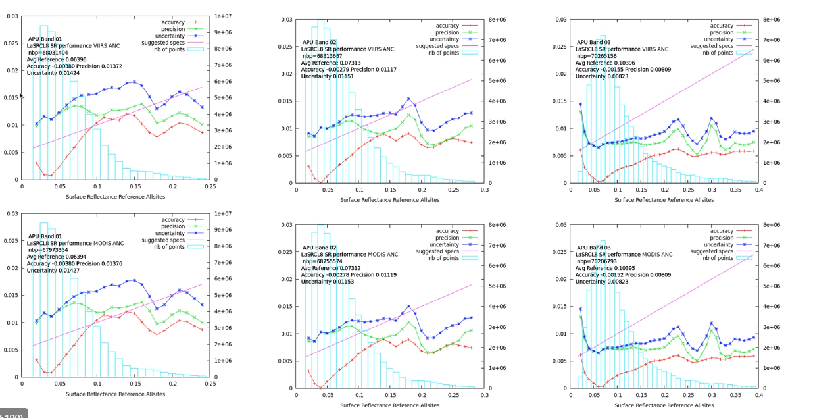
APU Analysis (Dr Vermote) – Top VIIRS Bottom MODIS
Ran the ACIX-II scenes set through LaSRC (Fortran version 3.5.5)
“No significant difference observed in L8 LaSRC surface reflectance when using the water vapor and ozone from MODIS or VIIRS”
Band 01
Band 02
Band 03
Notes:
The reflectance truth is obtained by correcting the TOA reflectance with 6SV using AERONET as input for water vapor and aerosol.
For reference also shown is the performance of the top of the atmosphere data (same dataset as LEDAPS and WELD).
The blue bars show the number of point used in each bin of reflectance.
The pink line represents the specified uncertainty based on a theoretical error budget of the collection 5 MODIS surface reflectance.

Slide 29
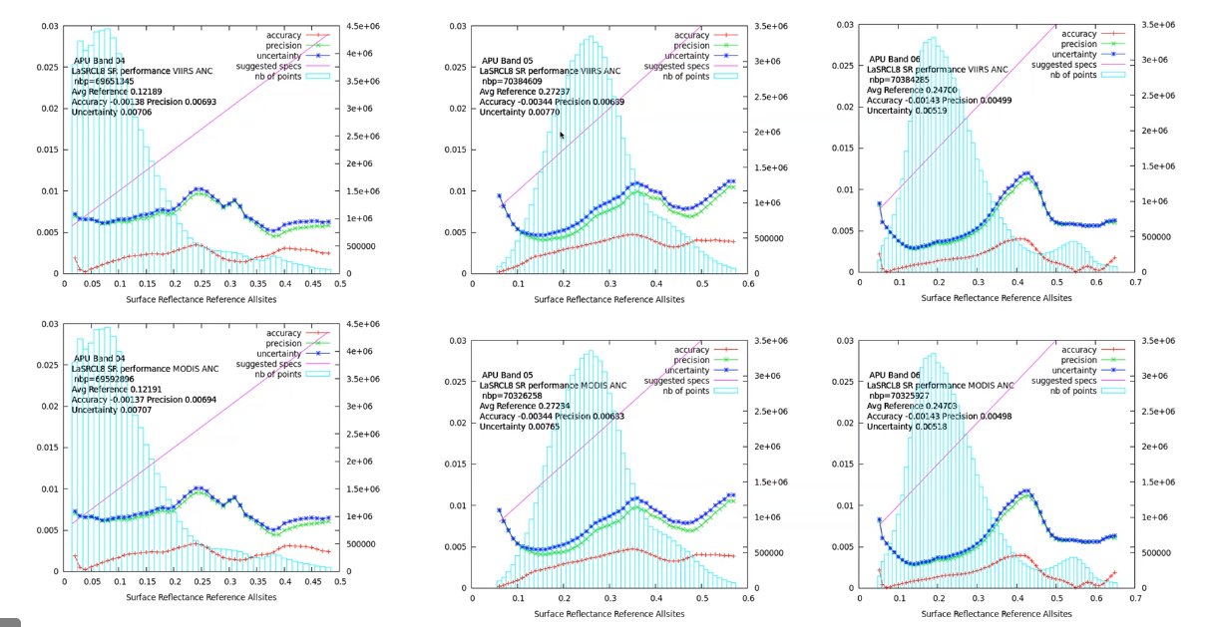
APU Analysis (Dr Vermote) – Top VIIRS Bottom MODIS
Ran the ACIX-II scenes set through LaSRC (Fortran version 3.5.5)
“No significant difference observed in L8 LaSRC surface reflectance when using the water vapor and ozone from MODIS or VIIRS”
Band 04
Band 05
Band 6
Notes:
Uncertainty of 0.007 for the Band 4 and 5 is very good.

Slide 30
SR Comparison - Scene-wide Statistics
Good overall agreement between the results
Boxplots created using the 99.7 empirical rule (μ ± 3σ)
High Humidity
High Humidity
Low Humidity
High Water Vapor
Low Water Vapor
ρ_{VIIRS} – ρ_{MODIS}
Slight overestimation at the Red and SWIR channels
Larger differences under high humidity condition
Notes:
Relative humidity:
LC08_L1TP_039037_20170611_20170628_01_T1 38.2%
LC08_L1TP_039037_20170729_20170811_01_T1 59.4%
LC08_L1TP_039037_20180817_20180829_01_T1 60.2%
The interquartile range (middle 50%) of the differences is almost zero, with maximum difference of 0.03 (units of reflectance).

Slide 31
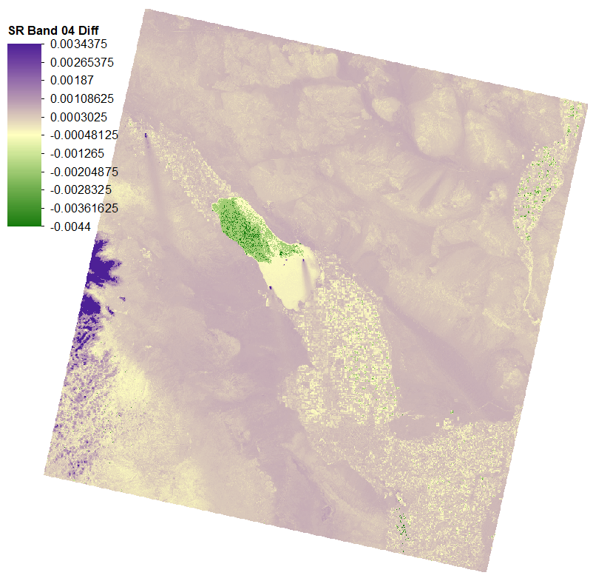
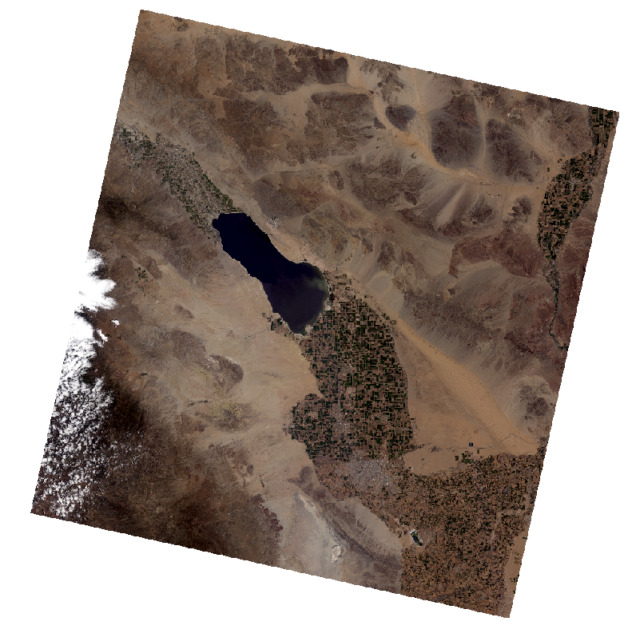
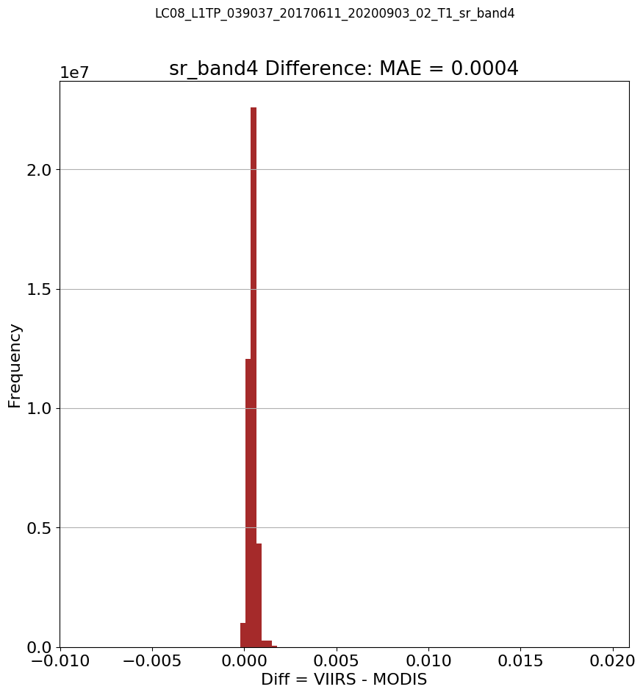
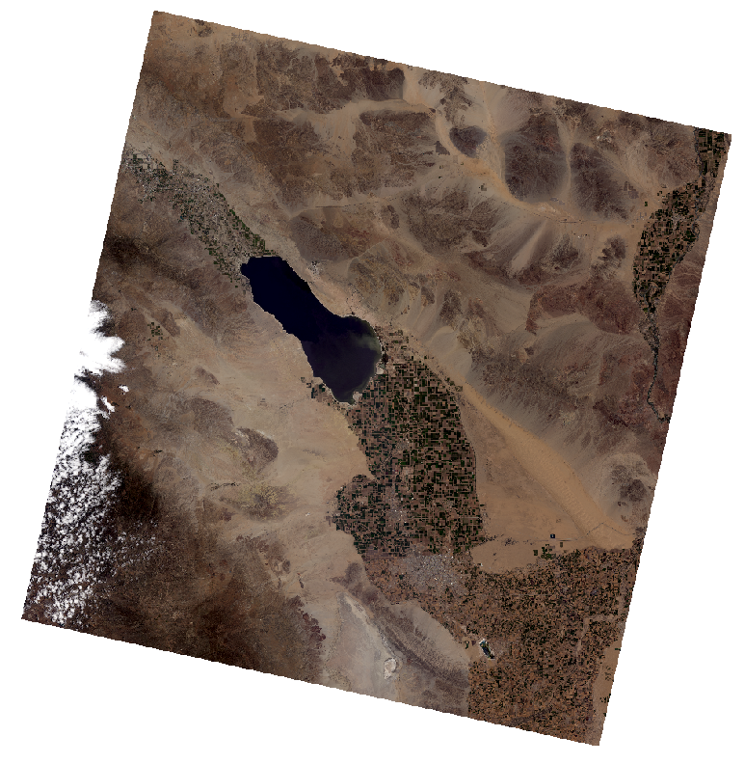
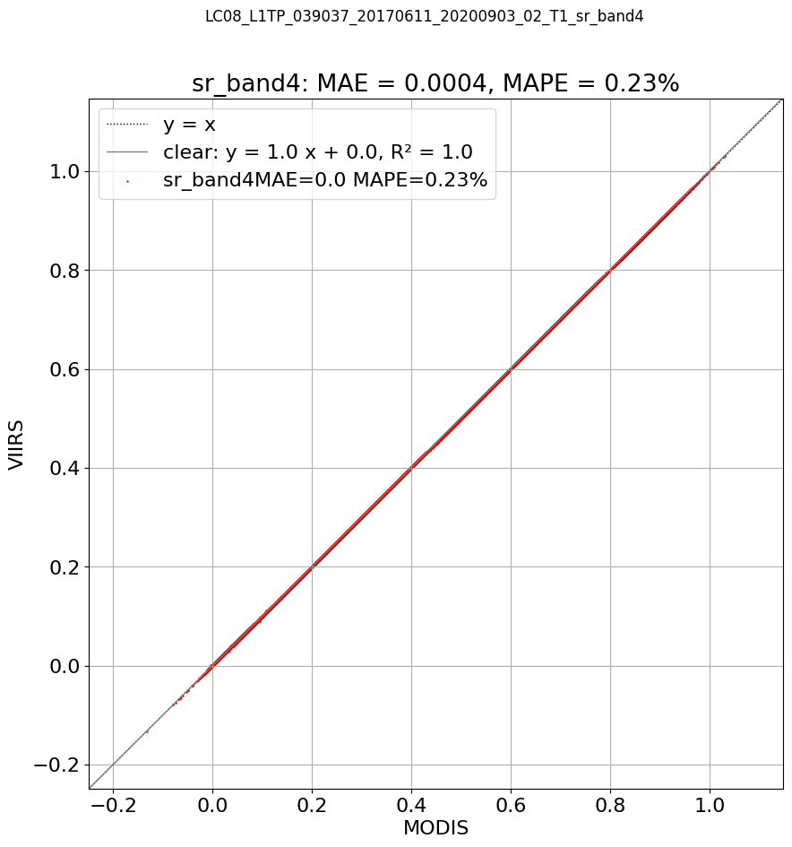
SR Difference Examples
Example 1 – Small differences in low humidity condition
Land cover dependence (vegetated, water, cloud)
SR RGB
(MODIS)
LC08_L1TP_039037_20170611_20200903_02_T1
(relative humidity: 38.2%)
SR RGB (VIIRS)
SR Band 04 Diff
(VIIRS - MODIS)
Notes:
Trailing artifact

Slide 32
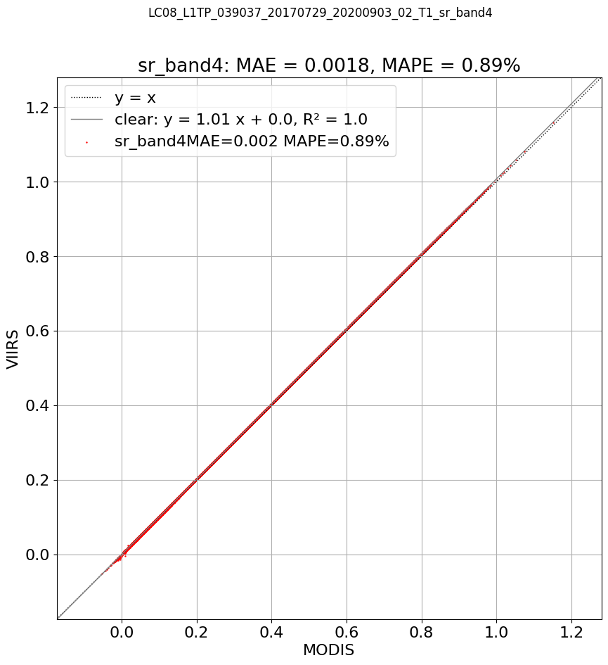
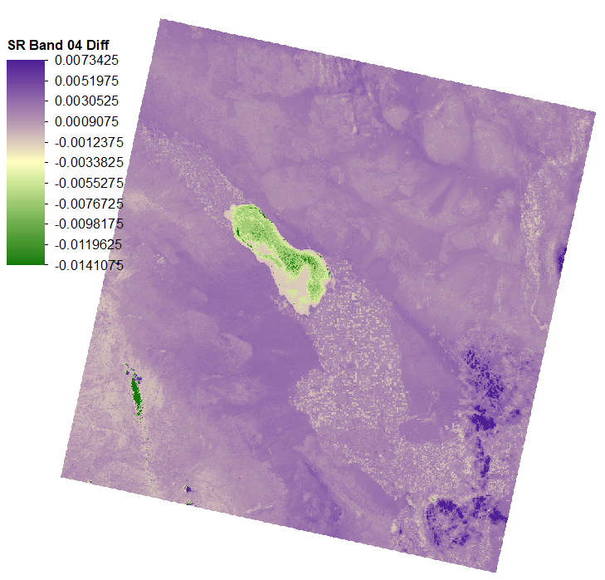
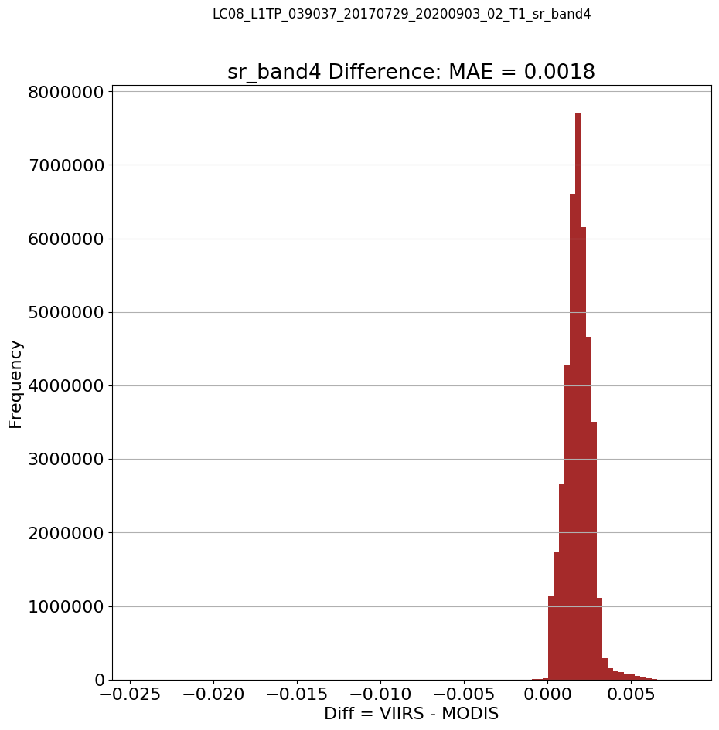
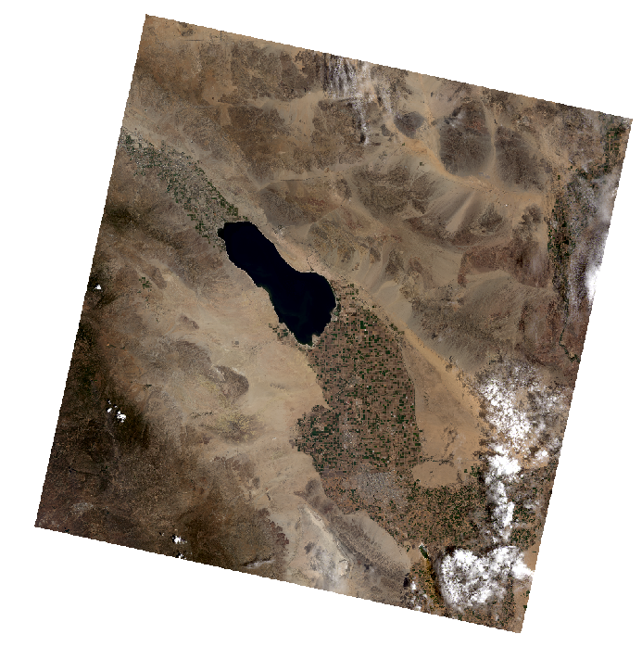
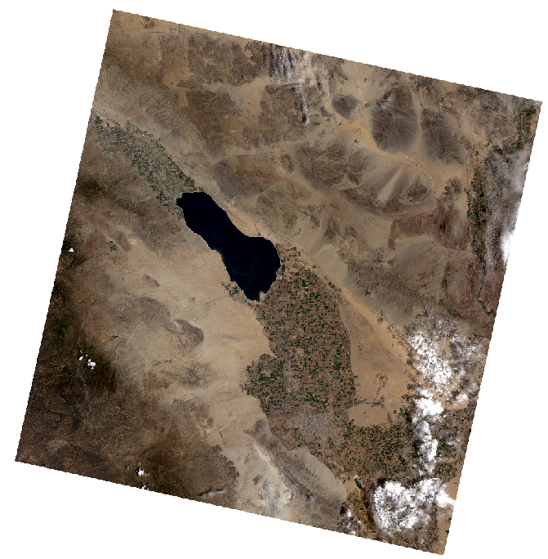
SR Difference Examples
Example 2 – Relatively larger differences (overestimation) in high humidity condition
SR RGB
(MODIS)
LC08_L1TP_039037_20170729_20200903_02_T1
(relative humidity: 59.4%)
SR RGB (VIIRS)
SR Band 04 Diff
(VIIRS - MODIS)

Slide 33
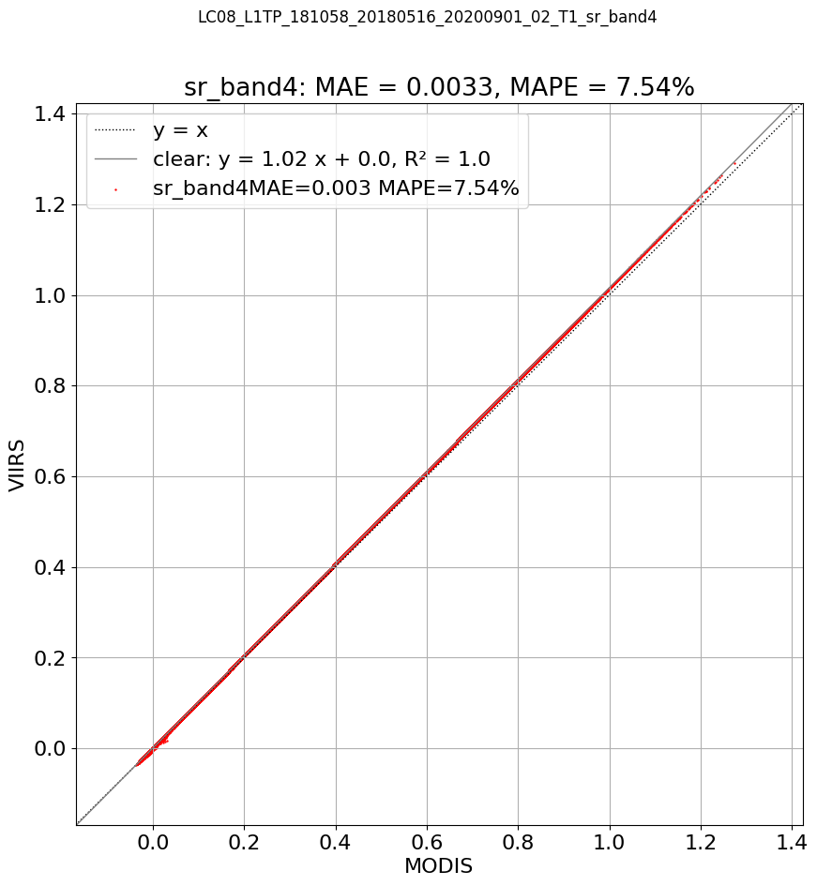
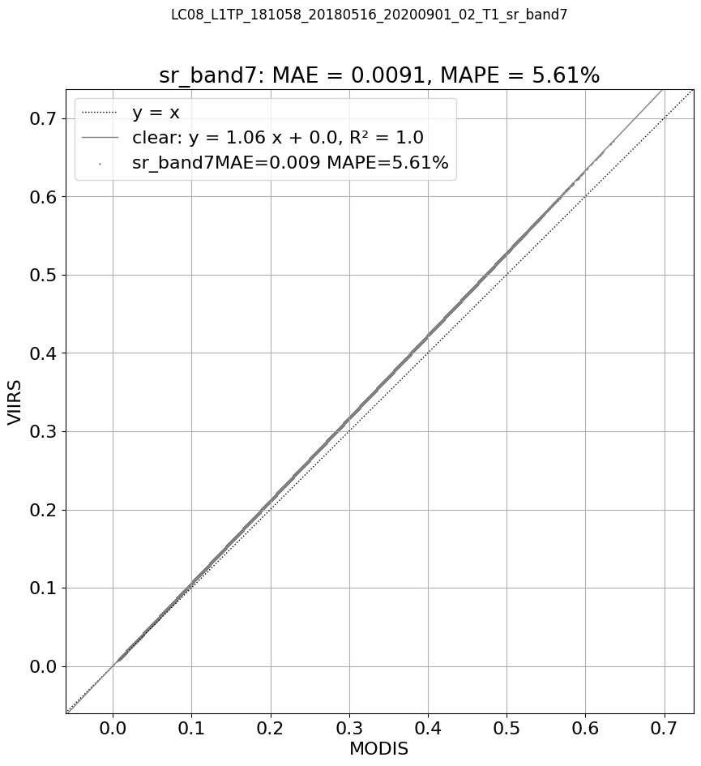
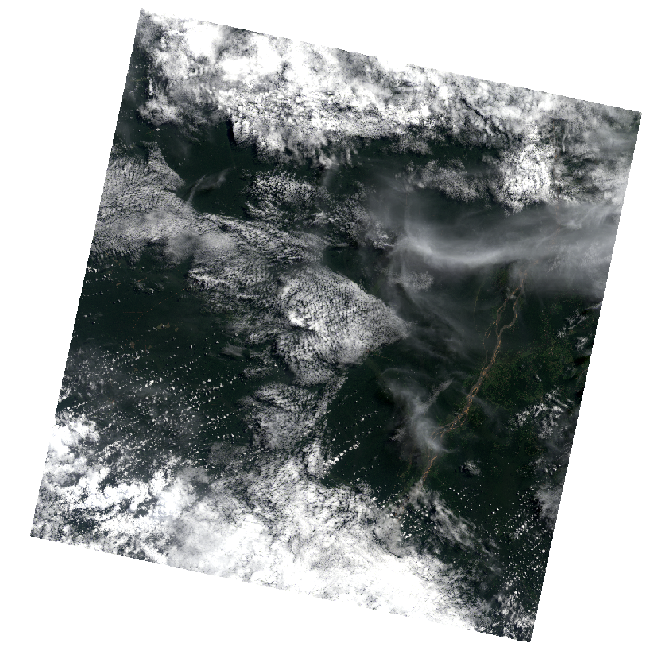
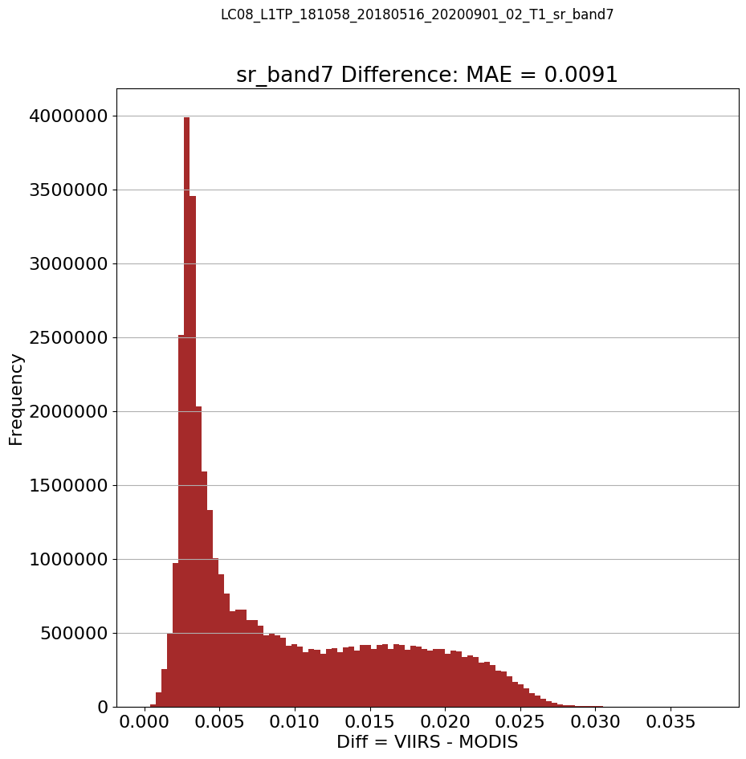
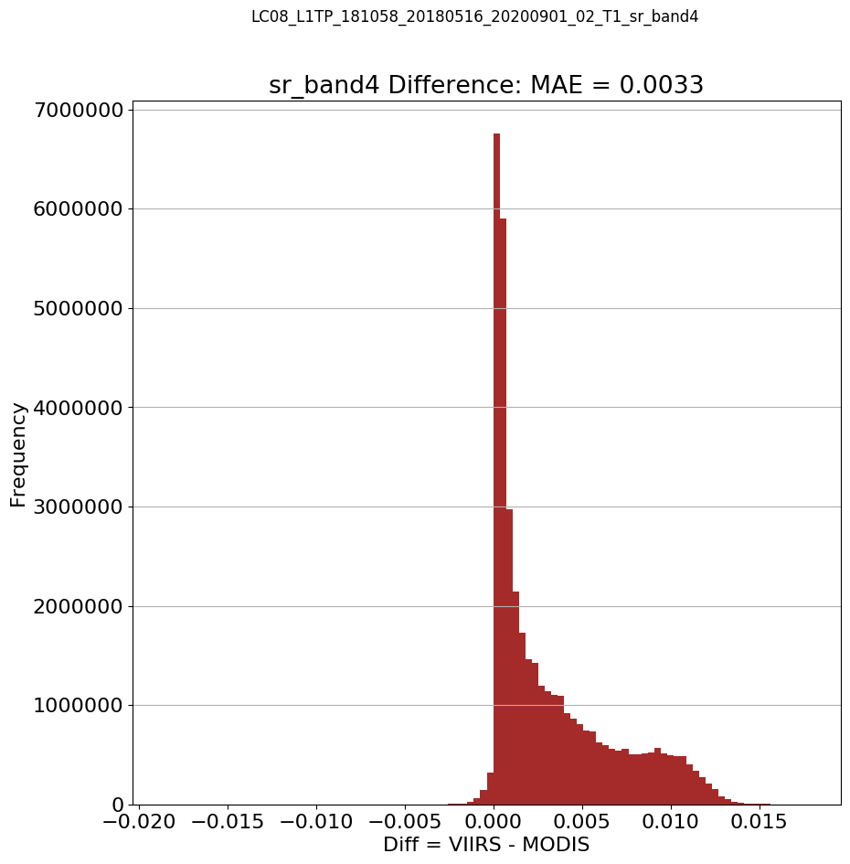
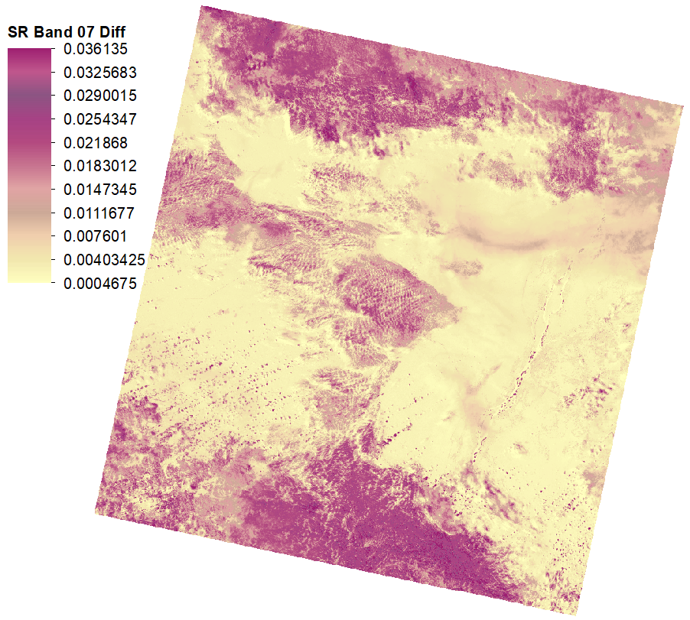
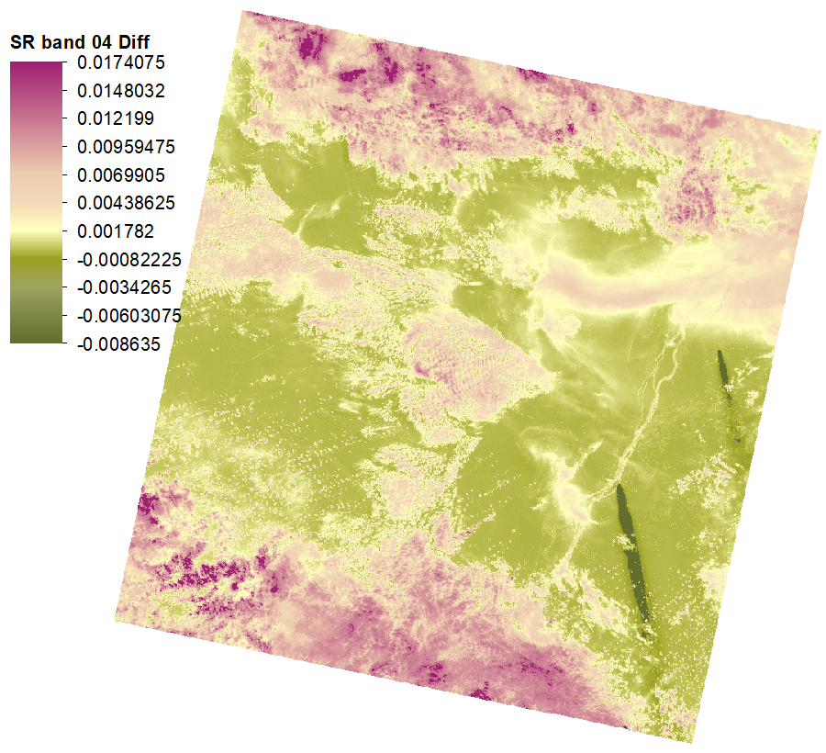
SR Difference Examples
Example 3 – Complex atmospheric condition near the equator with low Ozone level (Overestimation of SR at SWIR2)
SR RGB (MODIS)
LC08_L1TP_181058_20180516_20200901_02_T1
SR Band 04 Diff
(VIIRS - MODIS)
SR Band 07 Diff
(VIIRS - MODIS)

Slide 34
Difference Summary
Mean Absolute Difference (MAD) is very small for the VNIR bands (<0.0015) for the VNIR data
Highest percentage difference (6%) for the Red band.
Largest MAD ~0.0033 for the SWIR2
Despite its afternoon MLT crossing, switching to VIIRS should not impact the continuity of the Landsat C2 SR.
Notes:
Despite its afternoon MLT crossing, switching to VIIRS should not impact the continuity of the Landsat C2 SR.
The final SR difference is dependent on the land cover (water, cloud, vegetation cover.)

Slide 35
Growing Season
In temperate regions, which have warm summers and cold winters, the length of the growing season depends mostly on temperature. Some growing seasons last as long as eight months. Europe and most of the Americas enjoy long growing seasons like this. The farther away a place is from the Equator, the shorter the growing season. In regions near the poles, the growing season is sometimes less than two months. The U.S. state of Alaska has an average growing season of only 105
Elevation, or the height above sea level, also affects the growing season. This is because higher elevations usually have colder temperatures. High in the Sierra Nevada mountains in the U.S. state of California, the growing season lasts only 50 days, but along the state's southern coast, the growing season lasts 365 days.
There are two ways to determine the growing season. In temperate regions, the growing season is usually calculated by the average number of days between the last frost in spring and the first severe frost in autumn. The growing season can also be determined by the average number of days that the temperature rises high enough for a particular crop to sprout and grow. This measurement varies depending upon the crop. For rice to grow, the temperature must be at least 20 degrees Celsius (68 degrees Fahrenheit). Wheat, however, will sprout at just 5 degrees Celsius (40 degrees Fahrenheit).

Slide 36
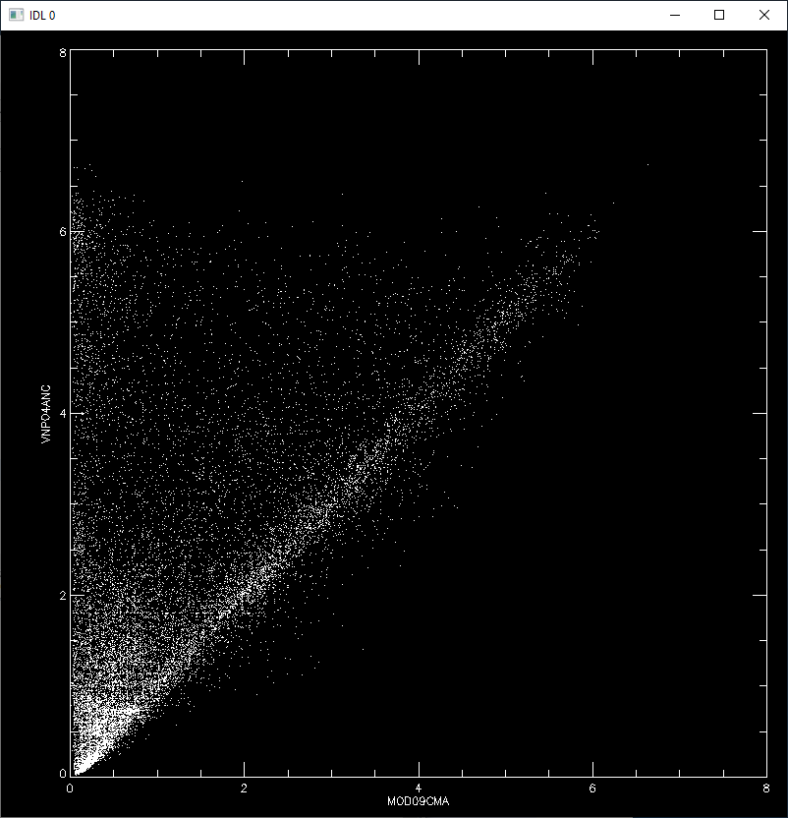
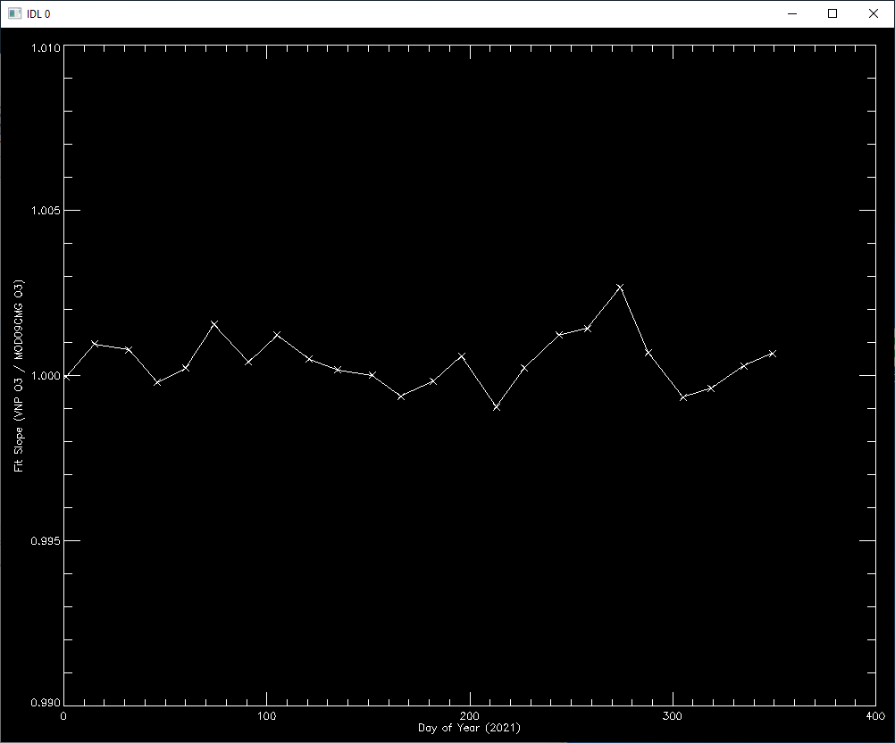
MODIS vs VIIRS CMG
The water vapor correlation is not great.
The regression fit has a slope of 4.8
There is some correlation along the 1:1 line, but there are outliers that do not correlate at all.
MOD09CMA water vapor data has some non-physical values, with a few points >8 g/cm^2 and a max value of 173.95 g/cm^2. That's an impossible value for total column water vapor, which usually maxes out at 8 g/cm^2 (80 kg/m^2).
Yearly trend plot for VNP09ANC ozone vs MOD09CMG ozone. They correlate very well, to within 0.3% of each other.

Slide 37
NOAA’s JPSS Mission
The Joint Polar Satellite System (JPSS) provides global meteorological data and observations of atmosphere, ocean, and land for short-term, and long-term monitoring.
The JPSS currently includes two satellites
Suomi National Polar-orbiting Partnership (S-NPP), and
JPSS-1 (NOAA-20).
It total, JPSS will include five satellites, launched on a regular cadence, to ensure that there are always at least two in orbit.
The next three satellites in the series (JPSS-2, -3 and -4) will launch in 2022, 2027 and 2032, respectively.

Slide 38
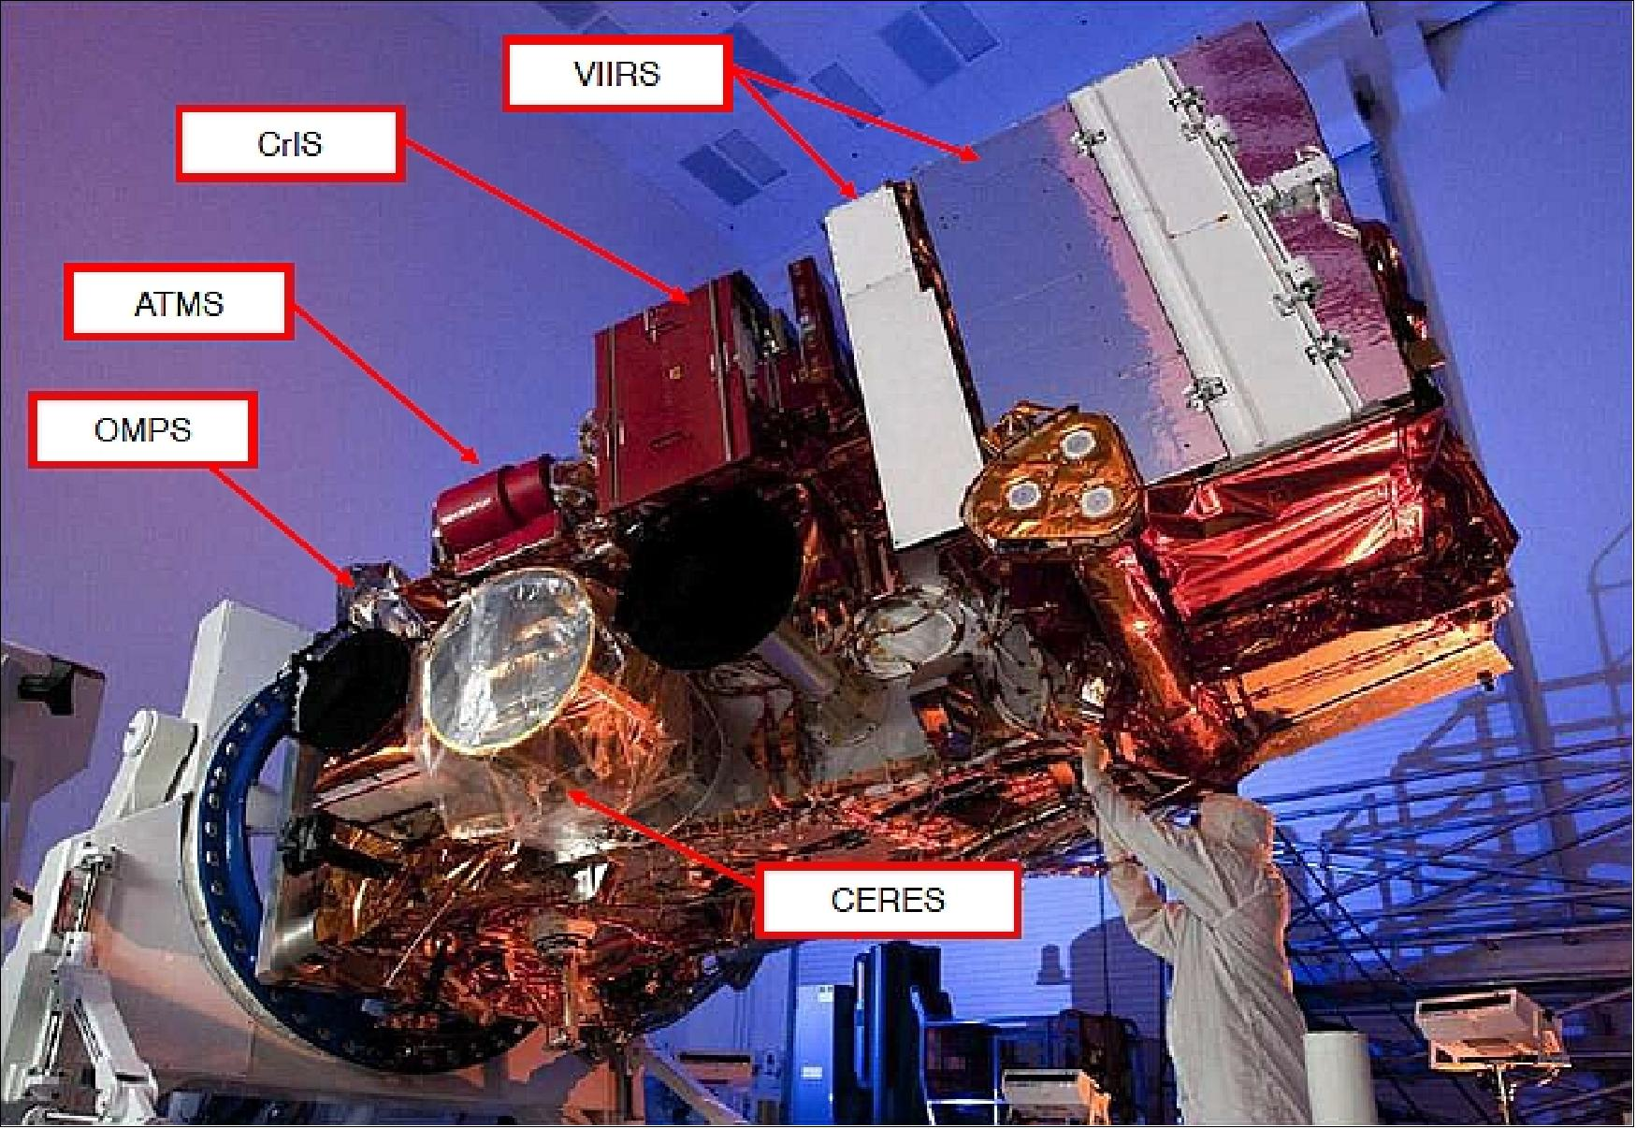
NOAA’s JPSS Mission
Each JPSS satellite carries at least four state-of-the-art instruments, including
Advanced Technology Microwave Sounder (ATMS),
Cross-Track Infrared Sounder (CrIS),
Visible Infrared Imaging Radiometer Suite (VIIRS),
Ozone Mapping and Profiler Suite (OMPS).
“VIIRS is one of the five major Earth observing instruments onboard S-NPP and JPSS. The VIIRS observations primarily focus on clouds and Earth surface variables, while the other instruments (CrIS, OMPS, ATMS, and CERES) are designed mainly to measure atmospheric variables and earth radiation budget.”

Slide 39
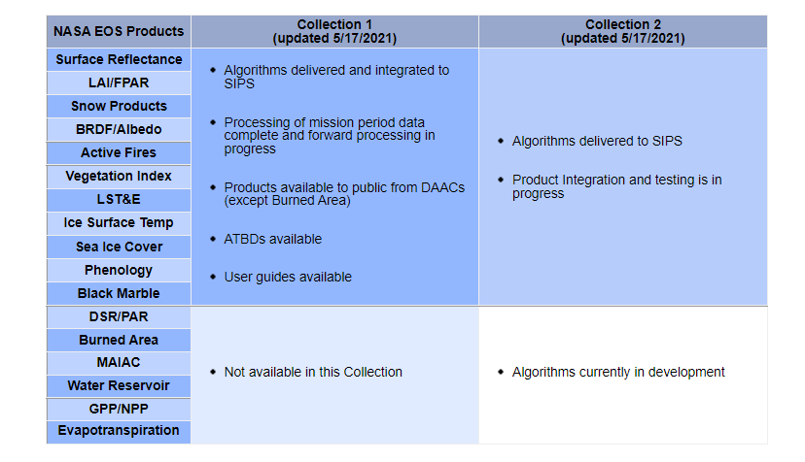
VIIRS C2 Processing Plans
Source: https://viirsland.gsfc.nasa.gov/Products/NASA/NASAprod.html

Slide 40
VIIRS CMG Data Ingest
JPSS1 products (VJ104ANC) will be treated as the primary source of the VIIRS CMG data, because S-NPP (VNP04ANC) might be decommissioned.
If the VJ1 product does not exist, then auxiliary data script will pull the VNP.
The VNP and VJ1 products will not be merged (unlike Terra/Aqua MODIS data), but instead one or the other will be used.
The primary/secondary source may be revisited upon successful on-orbit checkout of JPSS-2 and generation of similar CMG products.

Slide 41
LaSRC Modifications
A version of Fortran LaSRC code that handles VIIRS ancillary data was delivered to LSRD.
There are minimal code modifications for reading and handling the VIIRS auxiliary files.
Change in the default value for ozone (previous was 120, new is 110)
Change in the default value for water vapor (previous was 0.5, new is 2.5)
No other changes were made to the Landsat LaSRC algorithm.

Slide 42
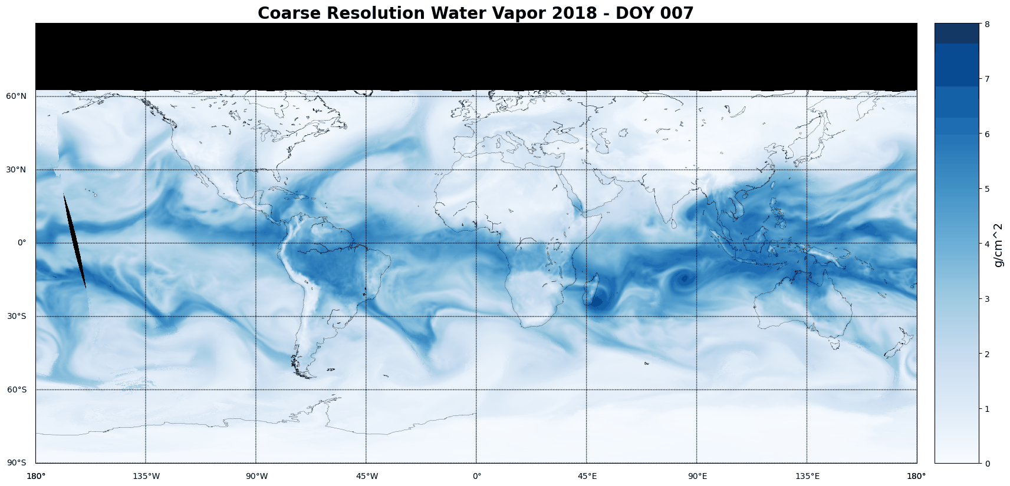
Gaps in VIIRS CMG Data
Missing data over high latitudes are associated with the high solar zenith angle where Landsat Surface Reflectance will not be processed (or is unreliable).
Orbital gaps over open ocean are present in most daily products.

Slide 43
Gap Filling – PI’s Approach
A gap filling code was delivered to LSRD which looks for monthly climatology data for gap filling.
Per-pixel monthly averages and standard deviations computed for each month of each year.
The code then relies on the monthly climatology for the target (T), previous (P), and next (N) month, for each date to fill in the current NoData pixel.
A weighting function is applied to determine the weights for the P, T, and N month averages.
For a product towards the end of the month, a weight is applied for the monthly average of the next month.
This is NOT ideal for an operational system
Requires monthly averages for each year to be computed and updated, using the entire month’s stack of VIIRS data.
For the nominal 2-day latency of Landsat 9, we won’t have a reliable average of the next or current month.

Slide 44
Gap Filling Methods
VIIRS CMG
Gap Filled using Monthly Climatology
The gap filling methods do not completely fill the polar regions (default water vapor and ozone values will be used for any L2SP over gaps).
The LaSRC code uses a default water vapor value of 250 (2.5 g/cm^2) and ozone value of 110 (0.275 cm.atm) for any remaining NoData pixel.
Gap Filled using Interpolation

Slide 45
Internal Science Verification - Scenes
No. | Scene | Note
1 | LC08_L1TP_028027_20191026_20200825_02_T1 | Cirrus - MN Lakes
2 | LC08_L1TP_041036_20190106_20200830_02_T1 | Urban area
3 | LC08_L1TP_045032_20200901_20200906_02_T1 | Fire smoke
4 | LC08_L1TP_125061_20190916_20200826_02_T1 | Cirrus and clouds
5 | LC08_L1TP_039037_20180817_20200831_02_T1 | High humidity - Salton sea
6 | LC08_L1TP_039037_20170729_20200903_02_T1 | High humidity - Salton sea
7 | LC08_L1TP_039037_20170611_20200903_02_T1 | Low humidity - Salton Sea
8 | LC08_L1TP_016026_20180512_20200901_02_T1 | High Ozone
9 | LC08_L1TP_121013_20180512_20200901_02_T1 | High Ozone
10 | LC08_L1TP_134011_20210531_20210608_02_T1 | High Ozone
11 | LC08_L1TP_008062_20210528_20210607_02_T1 | Low Ozone - High Water vapor
12 | LC08_L1TP_181058_20180516_20200901_02_T1 | Low Ozone
13 | LC08_L1TP_113060_20210528_20210607_02_T1 | High water vapor
14 | LC08_L1TP_144039_20180513_20200901_02_T1 | Low/High water vapor on northern/southern slopes of Himalayas
15 | LC09_L1TP_008062_20211230_20220121_02_T1 | High water vapor, Low Ozone
16 | LC09_L1TP_006022_20220306_20220306_02_T1 | High Ozone
17 | LC09_L1TP_172039_20220301_20220304_02_T1 | Low water vapor

Slide 46
Summary
The interquartile range (middle 50%) of the differences is almost zero, with maximum difference of 0.03 (units of reflectance).
Despite its afternoon MLT crossing, switching to VIIRS should not impact the continuity of the Landsat C2 SR.
The final SR difference is dependent on the land cover (water, cloud, vegetation cover.)

Slide 47
VNP04ANC
VNP04ANC Ozone
Unit: atm cm → 1 DU= 0.001 atm-cm
Scale factor: 0.0025
VNP04ANC Water Vapor
Unit: g/cm² → 1 g/cm² = 10 kg/m²
Scale factor: 0.01
Email from GSFC Group (11/24):
“I have raised this question with the LAADS DAAC manager. As a first step we will ask the atmosphere aerosol science team if it is ok to make VNP04ANC public from LAADS DAAC or LP DAAC.”

Slide 48
ECMWF ERA5
Ozone
Total Column Ozone tco3 [kg/m², SF:1.0 → 1 DU = 2.1415 x 10⁻⁵ kg[O₃]/m²]
Source: GOME, GOME-2, MIPAS, MLS, OMI, SBUV, SBUV/2, SCIAMACHY, TOMS
Water Vapor
Total Column Water vapor tcvw [kg/m²]
Source: AMSR-2, AMSRE, GMI, SSM/I, SSMIS, TMI, MVIRI, SEVIRI, GOES IMAGES, MTSAT IMAGER, AHI
Data URL
https://cds.climate.copernicus.eu/cdsapp#!/dataset/reanalysis-era5-single-levels?tab=overview
Option to set up API for data download
ERA-5 inputs: https://confluence.ecmwf.int/display/CKB/ERA5%3A+data+documentation
Notes:
1 Dobson Unit (DU) = 2.1415 x 10⁻⁵ kg[O₃]/m²
Dataset source: https://cds.climate.copernicus.eu/cdsapp#!/dataset/reanalysis-era5-single-levels?tab=overview
Set up API for data download: https://confluence.ecmwf.int/display/WEBAPI/Access+ECMWF+Public+Datasets
File format: GRIB stands for "General Regularly distributed Information in Binary form" and is a WMO (World Meteorological Organisation) standard format for archiving and exchanging gridded data. GRIB is a binary format, and the data is packed to increase storage efficiency. GRIB messages are often concatenated together to form a GRIB file. GRIB files usually have the extension .grib, .grb or .gb. (https://confluence.ecmwf.int/display/CKB/What+are+GRIB+files+and+how+can+I+read+them)

